Slide 1


Mary in Vincentian Spirituality
Notes:
Certainly, this Marian retreat may be presented anytime, and it is especially appropriate in May or October.

Slide 2

Opening Prayer: Alma Redemptoris
Loving mother of the Redeemer, gate of heaven, star of the sea, assist your people who have fallen yet strive to rise again. To the wonderment of nature you bore your Creator,
yet remained a virgin after as before.
You who received Gabriel’s joyful greeting,
have pity on us poor sinners.
Amen
Notes:
Let us pray this together, slowly.

Slide 3
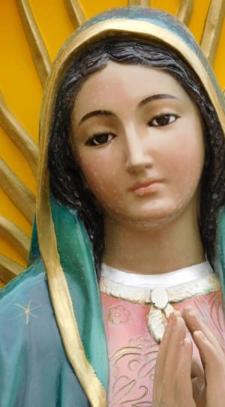
What to Expect
Why May is the month of Mary
Importance of Mary in the Society
History of the Immaculate Conception
Catholic devotions – The Rosary for
Vincentians
Notes:
This is an outline of what to expect during this retreat. Certainly, as Catholics we all have some level of devotion to our Blessed Mother. Today we’ll delve more deeply into how important she is to us as Vincentians.
From the beginning, Mary has had a privileged place for the Vincentian family. She is our inspiration to live our Christian attitudes and values. Our founder Frederic had a great devotion to our Blessed Mother so let’s dig deeper.

Slide 4
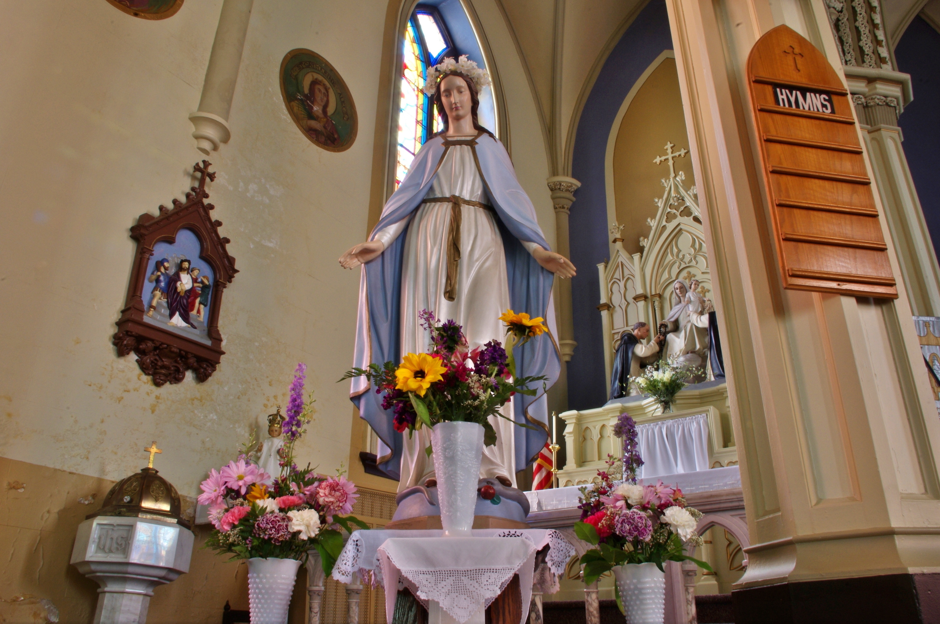
History of May as Mary’s Month
This Photo by Unknown Author is licensed under CC BY-SA
Notes:
How many of us celebrated Mary’s month by placing a crown of flowers on the statue of Mary in church? We waited anxiously to hear who was chosen for that special task.
For centuries, the Catholic Church has set aside the entire month of May to honor the Mother of God. The custom spans centuries and cultures, with roots going back as far as the ancient Greeks. During medieval times, the tradition of “thirty-day devotion to Mary” came into being. Also called, “Lady Month”, the event initially was held from August 15-September 14. Although it wasn’t always held during May, Mary Month included 30 daily spiritual exercises honoring Mary. The custom became especially widespread during the 19th century and remains in practice today.

Slide 5

Mary of the Immaculate Conception
Why the Society made
this choice

Slide 6
Where it all began:
300 AD – First documented discussions of Mary’s sinlessness
Scriptural References -
Luke 1:42 “Most blessed are you among women, and blessed is the fruit of your womb.^{t}
Luke 1:28 “Hail, full of grace; the Lord is with you.”
Notes:
First, a little history for context.
Mary, the Mother of Jesus Christ has always been seen as an essential part of the story of Jesus but starting as far back as 300 A.D. there was discussion of Mary’s purity – her sinlessness. The struggle for theologians over these hundreds of years was that Jesus came for everyone – all of us need a Redeemer. If Mary in fact was sinless, how is it that she needs a Redeemer. This was discussed worldwide in many ways and for centuries.
Many Church Fathers pointed to Scriptural references that make it clear Mary was sinless
The history of how this dogma evolved is too long for this retreat so let’s get closer to what likely impacted Frederic.

Slide 7
A few things that may have impacted Frederic’s thoughts
The plague in 1638 - Lyon was spared.
1643 – Lyon spared again
The people of Lyon had petitioned Mary for protection and were spared. There was a small shrine built in honor of Mary.
Lyon remained a center that really focused on Marian devotions.
Frederic Ozanam grew up in Lyon.
Notes:
As we see here, Frederic’s hometown of Lyon had long had a deep devotion to Mary. REFER TO SLIDE
The small shrine built in honor of Mary since the middle ages was frequently visited by young Frederic.

Slide 8
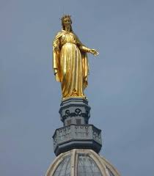
In 1852 a bronze statue of Mary was placed at Fouvière.
Beginning in that year, Lyon annually celebrates the Feast of the Immaculate Conception with a large candlelight procession.
Notes:
Then, in 1852, a bronze statue of Mary was to be placed at Fouviere on December 8th. The weather was stormy so it was thought that the event would have to be cancelled. But after intercession prayers to Mary the weather cleared. The people of Lyon lit candles in thanksgiving. The celebration has been done every year since 1852.
So certainly Frederic grew up in a city with a strong Marian devotion which he brought with him to Paris.

Slide 9
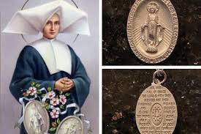
1830 – Mary appears to St. Catherine Laboure In Paris asking her to strike a medal.
1832 – First Miraculous Medals were made and were being distributed in Paris.
Notes:
Frederic had just arrived in Paris to study as a student in late 1831. He was there when the medal was released in 1832. He received one of the first medals distributed that year.

Slide 10
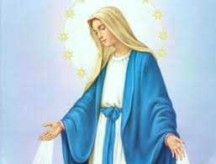
On December 8, 1854 the dogma of the Immaculate Conception was promulgated by Pope Pius IX.
From a young age, Frederic had depended on Mary, the Mother of God. Due to the moment in history and the acceptance of the Immaculate Conception among so many, it seems natural that the Society chose Mary of the Immaculate Conception as their patroness.

Slide 11
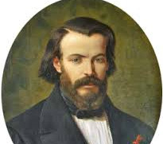
Frédéric died on the feast of Mary's birth, September 8. God’s Providence perhaps?

Slide 12
A Glorious Mystery from the Vincentian Rosary: the Resurrection
Name a time, an incident, or a situation in which after all your efforts and good work, you felt failure and frustrated. Then in almost an instant, things changed and worked out. You just experienced the joy of Jesus’ Resurrection, your own resurrection experience.
Notes:
Before reflecting on what Mary teaches us in Scripture, I’d like to mention the Vincentian Rosary, which some of you may already be using. If you’re not familiar with it, this slide is an example of what is offered.
Spiritual Advisors can use the Vincentian rosary for reflection. For example take one glorious mystery and share it with the members. Then have the members share how it speaks to them. Of course, all members can use this Vincentian rosary for private prayer.
Have copies of Vincentian Rosary available if possible.
Now that we better understand from history why Mary is the Society’s Patroness, let us reflect on Mary in Scripture.

Slide 13
What We Can Learn from Mary
When we think about all we learn in the Gospels, we notice that we hear Mary speak just a few times.
How much then can we learn from our Mother?
The events themselves tell us much.
Notes:
REFER TO THE SLIDE
When we think about all we learn in the Gospels, we might not notice that we hear Mary speak just a few times. However, the events themselves tell us so much.

Slide 14
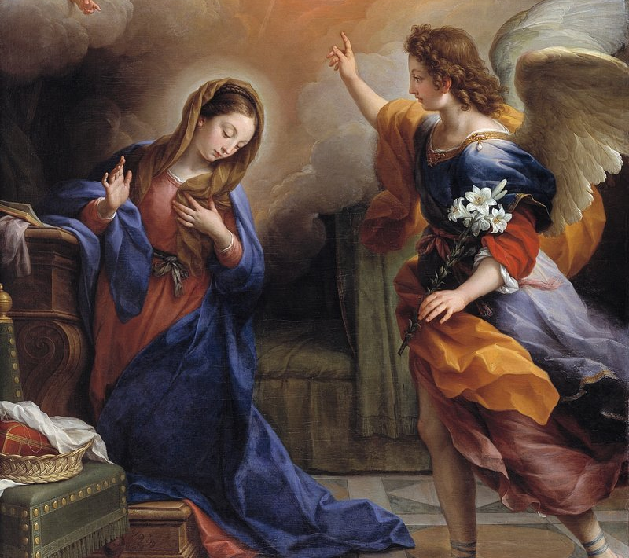
What Mary Teaches Us in the Annunciation
  Humility prepared and sustained Mary in the offering of herself
  to God.
  Like Mary, we must give ourselves to God to accomplish His work.
    Serving in Hope, Module II: Our Vincentian Spirituality, p.38
Notes:
Reflecting on the Annunciation, a couple of verses are striking. First, in Luke we read that Mary was “perplexed” by angel Gabriel’s words that the Holy Spirit will overshadow her. It’s important to note that Mary did not question who the Holy Spirit is. As a devout Jewish woman she would have been aware of the Holy Spirit.
That phrase can fill us with hope since even the Blessed Mother is confused –just as we often are by God’s plan! Second, it’s comforting that Mary questioned the angel! What the angel told her didn’t make sense, so she asked “… how can this be?” Notice that Mary asks “how” can it be, and not simply “can” this be? That shows her faith in God’s power. She wasn’t questioning whether or not what the angel said could be done, but only how it would be done. During the Annunciation, we can learn the importance of humility and surrendering ourselves to God throughout our lives.

Slide 15
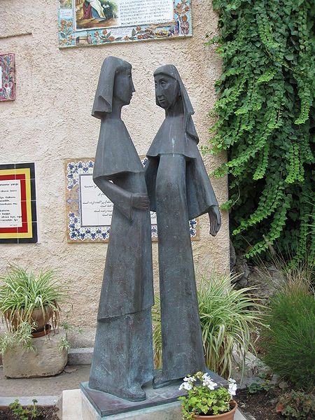
What Mary Teaches Us in the Visitation
During those days Mary set out and traveled to the hill country in haste to a town of Judah, where she entered the house of Zechariah and greeted Elizabeth.
Luke 1:39
Notes:
In reflecting on Mary’s Visitation to her cousin Elizabeth, we can learn quite a bit about how to serve our neighbors in need. Let’s reflect more deeply because there is something so powerful about Mary’s visit to her cousin.
First Mary set out and traveled to the hill country – this was not an easy trip, and she undoubtedly had some difficulties, but she went because she knew her cousin would need help. Mary’s comfort was not primary, Elizabeth’s was. This can be a powerful reminder to us when we sometimes must deal with difficulties of assisting people in need, who often take us out of our comfort zone. Can we set aside our discomfort, our frustration and go willingly and with compassion to the friends who need us?
Notice that she traveled “in haste.” It might be good for us as Vincentians to reflect on this short phrase. Do we go out in haste to help our neighbors? Of course it’s not always possible, but how often do we hesitate, or make our friend in need wait until another day?
We need to pay attention to the statement that Mary went to her cousin and “entered the house.” Mary often acted with charity, not waiting for others to come to her, which we’ll see again with our next slide Might this not be another teaching from Mary – that we must go to others where they live?”
One more striking detail that we might want to reflect on deeply within our conferences: “And Mary remained with her about 3 months and then returned to her home.” (Lk1:56) Perhaps Mary needs to be our guide in our conferences as we discern how to help our friends walk out of poverty. Could Mary’s decision to stay with her cousin for 3 months encourage our decisions to stay with our friends in need for more than one visit, and rather be with them for more long-term problem solving? As always, such a decision needs discernment with the Holy Spirit as well as with Mary, but it does bear further reflection.

Slide 16
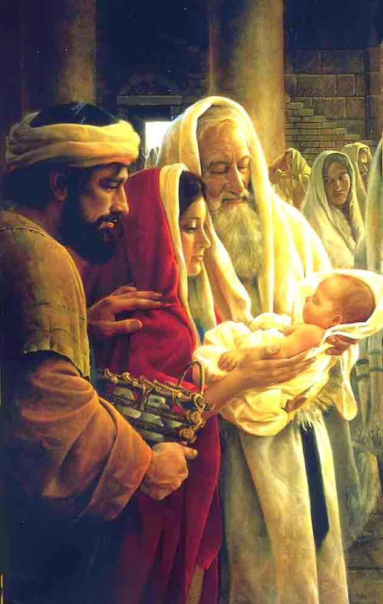
What Mary Teaches us: Presentation in the Temple
“…When the days were completed for their purification according to the law of Moses, they took him up to Jerusalem to present him to the Lord,…”
“… he took him into his arms…”
Luke 2:22, 28
Notes:
Although Mary doesn’t speak in this Gospel, as Vincentians we still can learn from her.
First, we note that Mary and Joseph live their lives guided by the law of the Lord. Likely that wasn’t always easy, but they made no excuses, didn’t complain, but fulfilled the law. This was important enough that the evangelist included this event in his Gospel. It might be good for us to consider what we live by. First of course, are the teachings of Jesus which are clearly presented in our Catholic teachings. But as Vincentians we also have our Rule which gives us guidance and can answer most of our questions or dilemmas. Primary in the Rule is that spirituality is at the center of our Vincentian vocation, followed by service and friendship. Perhaps we need to go back and read our Rule within our conferences, as well as reflect on the Scriptures, asking Mary for her insight.
It’s striking that Mary trusted Simeon enough to allow him to take Jesus into his arms. Was that easy for Mary? Did she know Simeon? Was it her trust in God that allowed her to give her newborn to this prophet? Perhaps we can ask Mary to help us when we are anxious or uncertain about the people we encounter, trusting in the Lord as she did.
It has been noted that this Gospel sometimes is called “the story of encounter.” How appropriate for us – our encounters with God’s children in need are also our encounters with Christ. What does Mary teach us in this encounter story? She and Joseph are in the temple likely packed with crowds. They probably were surprised by Simeon and by Anna but they connected with them, didn’t turn from them, trusted in the Lord and accepted the unexpected encounters. Can we say the same? Where do we see the Lord? Are there times when we turn away? Can we recognize that we often may miss Him in the crowds of our life?

Slide 17
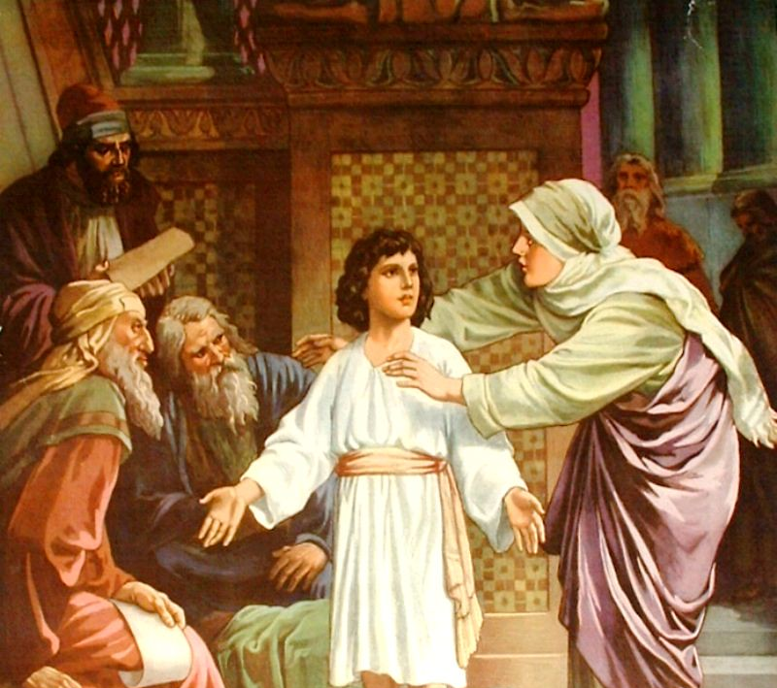

What Mary Teaches Us When Jesus is Lost
“When they did not find Him, they returned to Jerusalem
to search for Him.
After three days
they found Him
in the Temple…”
Luke 2:41-52
Notes:
What might Mary be teaching us here? First, anyone who’s ever lost track of a child – our own or someone else’s – even if only for a few minutes, can understand the anxiety of Mary and Joseph. We also understand Mary’s question of why when she found Jesus. But let’s reflect more deeply.
Mary asks her son WHY? Like us, Mary has questions, she and Joseph don’t understand… just like us. Mary did not always understand what was happening, she has anxious moments, and she questioned her son. It’s encouraging that, like us, Mary sometimes struggles to grasp what it means to have Jesus in her life. But what is possibly most important for us to learn from Mary is that she treasured in her heart everything that happened. She remembered every event, what she heard and saw and then reflected on what it all meant. That is an important lesson for us to learn as Vincentians. We need to reflect on the people and situations we encounter, praying for understanding, wisdom and compassion.
How often in our conferences and councils are we anxious because funds are running low, or our membership numbers are down? Do we take those anxious situations and ask God why? Are we honest in our prayers even when we don’t understand how or when or through whom God is answering? Is our spirituality deep enough that we can dare to ask God, WHY? Do we listen for His answer?
Again, Mary keeping everything in her heart is a core teaching for us in our Vincentian vocation. Doing that might help us move from focusing on tasks to focusing on the relationships in our encounters and recognizing Christ present, and the Holy Spirit guiding us.

Slide 18
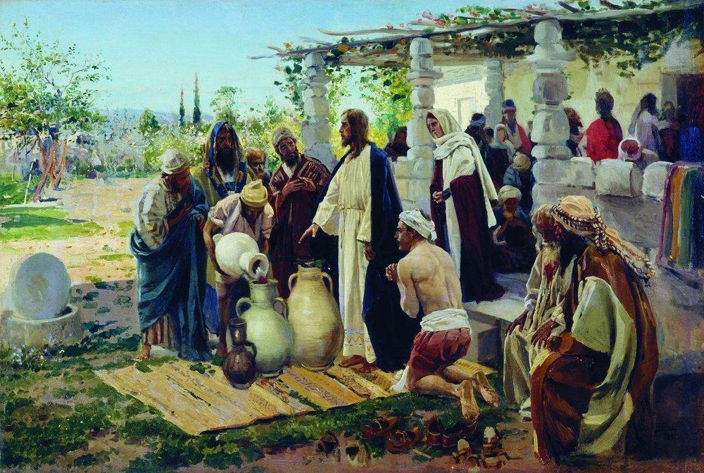
Another Important Teaching
His mother said to the
servants, “Do whatever
He tells you.”
(John 2:5)
Notes:
At the wedding Feast at Cana Mary, ever attentive to the needs of others, notices that the wedding couple has run out of wine. She approaches her son, Jesus, and lets him know about the situation. Then she says her final words in scripture.
His mother said to the servants, “Do whatever he tells you.” (John 2:5)
Mary’s words are profound and can provide an entire lifetime of meditation. Her words, “Do whatever he tells you,” do not only apply to the waiters at the feast, but to every Christian throughout history.
“When the wine gave out, the mother of Jesus said to him, ‘Thay have no wine.’ And Jesus said to her, ‘Woman, what concern is that to you and to me? My hour has not yet come.’
Notice that although Mary lets Jesus know about the situation, she doesn’t ask Him if He can do something. She has complete trust that He will accomplish what is needed. Can our faith be that strong when we reach out to the Lord in prayer?
Her mission has always been to point others to her son, Jesus, and to urge them to follow his commands. Mary leads others to Christ and speaks those words to us today.
Furthermore, these words highlight the need for faith in action in our lives of discipleship. We can’t simply profess our faith in Jesus Christ, we must also live it out, believing He will accomplish what He promises.. Mary had complete trust in her Son. Without a word to Him, she expects Him to respond. It behooves us to act on her words: “Do whatever Jesus tells you.” What is Jesus telling us as we live our Vincentian vocation, and what is our response?”

Slide 19
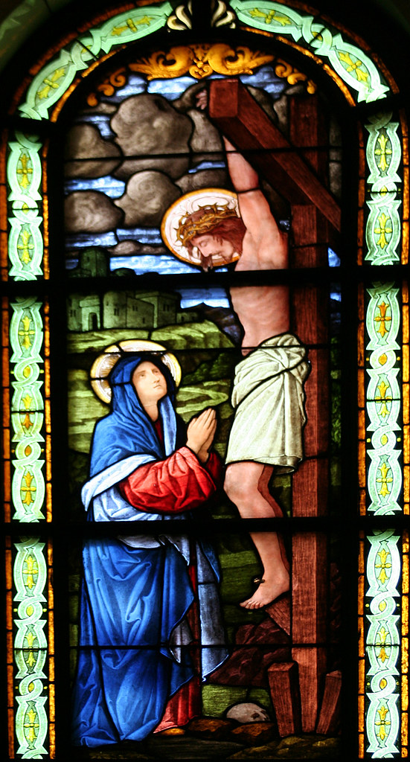
When Jesus saw His mother and the disciple whom he loved standing beside her, he said to his mother, “Woman, here is your son.” Then he said to the disciple, “Here is your mother.” And from that hour the disciple took her into his own home.”
John 19: 26-27
Notes:
As we witness Mary’s agony at watching her Son suffer and die for all of us, what can we learn from Mary’s presence here?
First, Mary is showing us how to bear witness to the suffering of others, even as we suffer with them, with love and compassion. Certainly, Mary must have been overwhelmed with grief and the pain of watching her son suffer such atrocities. But she also teaches us that we cannot avoid suffering, nor can we always end someone else’s pain and suffering. Again, Mary teaches us that faith in God’s love helps us help others.
What also is striking is that Mary apparently accepts the support and care of the disciple Jesus is providing. She understands – as we must – that we need others to help us with our struggles, our pain, our doubts. Jesus is always with us, but we also need each other to keep going. Mary does not speak, but the final phrase tells us that she accepts that she needs to take care of herself and Jesus himself has chosen who will help her. Our Vincentian friendships also can provide the same support and compassion when our vocation becomes overwhelming. Mary reminds us to accept that gift from others, so we may continue serving God’s children.

Slide 20
Mary’s Inspiration for Us
In her life Mary fully and responsibly accepted
the will of God.
She heard the word of God and acted on it.
Charity and the spirit of service were the driving forces of her actions.
Mary unreservedly allowed herself to be guided by the Spirit; her life was in the Spirit.
Notes:
We can find all we need for our lives as Vincentians by following Mary’s example. Refer to the slide:
** She always did the will of God. When she heard God’s word she acted.
** Service with compassion and empathy drove all her actions.
++ Mary always followed the guidance of the Holy Spirit.
Although the Holy Spirit coming at Pentecost had not yet happened during these events in her life, Mary certainly was aware of the Spirit, as evidenced at the Annunciation. The Holy Spirit is a powerful presence from the time of creation and throughout the history of Israel. Two examples: (Exodus 35.31 and 1 Samuel 16.13) Certainly Mary was open to the guidance of the Holy Spirit in her life.
THE ABOVE inspirations (slide) is what we can learn from Mary.
When we accept that our spirituality remains the core of our Vincentian vocation, then we become active contemplatives.
Active because we give of our time and our resources to serve God’s children
Contemplative because our service flows out of our spirituality

Slide 21
Final Reflection
Mary always did God’s will: when she heard God’s word, she acted.
How often do I listen for God’s word, and then follow His will?
How do I hear God’s word? How do I know His will?
Service with compassion and empathy drove all Mary’s actions.
Am I able to serve with compassion and empathy regardless of the situation? When is it most difficult for me to serve this way?
Do I remember to ask for guidance from the Holy Spirit?
How do I recognize the Spirit’s guidance?
Notes:
If time: reflect personally for a few minutes and/or share at your tables.
Hopefully this retreat time leads all of us to spend more time going to our Mother Mary, asking for her intercession, her support and guidance.
Although we have very few words from Mary in the Gospels, we can learn much from Mary through praying with the Scriptures. This doesn’t mean all will be easy, or that we’ll remember her words when we most need them, but we do know that Our Lady of the Immaculate Conception is always walking the Way with us.
FINAL SLIDE: CLOSING PRAYER
.

Slide 22
Closing Prayer (Pope John Paul II, 2002)
Pray, O Mother, for all of us.
Pray for humanity, for those who suffer poverty and injustice, violence and hatred, terror and war.
Help us to contemplate with the rosary the mysteries of Him who 'is our peace’, so that we will all feel involved in a persevering dedication of service to peace.
Look with special attention upon the land in which you gave birth to Jesus,
a land that you loved together with Him, and that is still so sorely tried today.
Pray for us, Mother of hope!
'Give us days of peace, watch over our way.
Let us see your Son as we rejoice in heaven'. Amen!
Notes:
Thank you for your attention.

