Slide 1
Ozanam Orientation
Formator and Presenter Training

Slide 2

Opening Prayer
“Come Holy Spirit fill the hearts of Thy faithful, and kindle in them the fire of Thy love.”
“Send forth Thy Spirit, and
they shall be created.”
“And the whole face of the
earth shall be renewed.”
- Opening prayer by Bailly at first meeting
Notes:
The prayer on the slide was offered by Emmanuel Bailly, the first Conference President, who is also considered to have been the first Spiritual Advisor.
Suggested centering meditation and call the presence of the Holy Spirit into our midst:
Call the participants together and begin with some cleansing breaths and then have the group say the prayer a first time.
Deep Breaths and then talk about the importance of the holistic approach to our ministry: mind, body and spirit
More deep breaths and ask folks to do a body scan and find places where they might be uncomfortable or distracting and spend a few moments more in deep breathing. Note: the relaxation response is elicited with deep abdominal breathing. Mostly this is a welcoming of the body and any distractions. Then have group read the prayer again
More deep breaths and ask folks to search any thing they have brought in their minds that might be troubling or distracting. Continue with the breaths and have folks welcome those intrusions, acknowledge them and suspend all the striving. Then have group read the prayer again
More deep breaths and ask folks to check in with their spirit, and the same exercise of deep breathing and welcoming and nurturing themselves. Then have group read the prayer again
Should take around ten minutes

Slide 3
Spiritual Reflection
FEAST OF BLESSED Frédéric OZANAM
September 9
Listen carefully to the Word
Luke 10: 25-37
Notes:
Faculty: Take your time to slowly read the words of this Gospel from Luke
“And who is my neighbor? Jesus replied: “There was a man going down from Jerusalem to Jericho who fell in with robbers. They stripped him, beat him, and then went off leaving him half-dead. A priest happened to be going down the same road; he saw him but continued on. Likewise there was a Levite who came the same way; he saw him and went on.
But a Samaritan who was journeying along came on him and was moved to pity at the sight. He approached him and dressed his wounds, pouring in oil and wine as a means to heal. He then hoisted him on his own beast and brought him to an inn, where he cared for him. The next day he took out two silver pieces and gave them to the innkeeper with the request: “Look after him, and if there is any further expense I will repay you on my way back.” Which of these three, in your opinion, was neighbor to the man who fell in with the robbers?” The answer came, “The one who treated him with compassion.” Jesus said to him, “Then go and do the same.”

Slide 4
Reflection continued
“The humanity of our days seems comparable to the traveler of whom the Gospel speaks…in our turn, weak Samaritans, worldly and people of little faith that we are, let us dare nonetheless to approach this great sick one. Perhaps it will not be frightened of us.”
Notes:
Perhaps let one of the participants read here, there are two slides to complete this quote from Bl Frédéric. The reverence for the person in need is evident in this slide, perhaps allow participants to speak to the Humility so apparent in the sacred approach to the neighbor.

Slide 5
Reflection continued
“Let us try to probe its wounds and pour in oil, soothing its ear with words of consolation and peace; then, when its eyes are opened, we will place it in the hands of those whom God has constituted as the guardians and doctors of souls, who are also, in a way, our innkeepers in our pilgrimage here below, so as to give our errant and famished spirits the holy word for nourishment and the hope of a better world for a shield.”
Bl. Frédéric Ozanam
(Letter to Leonce Curnier, 23 Feb 1835)
Notes:
This part of the quote historically is intended to help the neighbor find spiritual grounding through the experience of gentle caring for the physical and emotional spiritual needs by the Vincentian in preparation for a return to the church community. “we will place it in the hands of those whom God has constituted as the guardians and doctors of souls, who are also, in a way, our innkeepers in our pilgrimage here below, so as to give our errant and famished spirits the holy word for nourishment and the hope of a better world for a shield.”
In Frédéric’s time, the guardians and doctors of souls were intended to mean the clergy and the church, this sense of return to the place where the soul is nourished. In our times, this could totally be applicable…but not always. With the great diversity of neighbors we serve, we still hope that we are able to minister to spiritual needs, but the guardians and doctors of souls could be the persons own faith community.

Slide 6
Reflection continued
Frédéric does not call Christians “good Samaritans,” as one would expect, but “weak Samaritans.”
How are you in your Conference, indeed weak human beings who attend to other weak human beings by acts of compassion?
Frédéric Ozanam, defender of faith, pray for us.
Frédéric Ozanam, promoter of hope, pray for us.
Frédéric Ozanam, apostle of charity, pray for us.
Frédéric Ozanam, exemplary husband and father, pray for us.
Frédéric Ozanam, lover of poverty and the poor, pray for us.

Slide 7
Reflection continued
Frédéric Ozanam, advocate of the dignity of the human person, pray for us.
Frédéric Ozanam, servant of the truth, pray for us.
Frédéric Ozanam, model for Catholic teachers and professors, pray for us.
Frédéric Ozanam, disciple of St. Vincent De Paul, pray for us.
Frédéric Ozanam, faithful son of the Church, pray for us.
Frédéric Ozanam, our intercessor at the throne of God, pray for us. Amen

Slide 8
Introductions
Your Name
Conference and District /Diocesan Council
What is your goal? Formator or Presenter?
What do you hope to take home from this?
Notes:
Leader of this workshop should provide a few moments for people to think about the last bullet if they are to share this aloud. This will be helpful for the participant to truly bring forward in their own mind – their hope for the day.
It might be helpful to use a flip chart to scribe some of the themes that emerge from a sharing of these hopes

Slide 9
Presenter Training Agenda
Day 1
Introduction
Objectives
Guidelines
Vincentian Formation
Council Formation Plan
Organize and Present the Orientation
Section by section advice
Day 2
Ozanam Orientation 2020
General speaking advice
Practice session
Presentations
Additional Topics
Notes:
For the South Central Formation, disregard notes below, It will be two days, we will notify folks and assign parts in advance. It will most likely be a presenter training, with a follow up visit and assessment at the council OO for those that desire to be Formators
Agenda normally is two days.
Day 1 is shown above.
Students then study their assigned parts in the late afternoon and evening.
Day 2 consists of each student presenting one section to the class, and hearing a critique by instructor and other students.
For a large formation class, two instructors will allow you to split the class into two rooms and run double sessions.
Day 3 ideally is a live Ozanam Orientation featuring the trainees.
If (and only if)
students are all existing presenters
AND the area already has a solid Formation Plan
AND students are given Formator Guide and OO slides in advance and assigned a section to study
AND they actually study
It is possible to cover the agenda in one long day, like this: DO WE REALLY WANT TO GIVE THIS OPTION AT ALL BECAUSE THEY’LL ALL TAKE IT!
Morning:
- Part 0: just show the Formation Plan. Don’t ask them to create one.
- Part B: as needed.
- Part A: can be skipped entirely.
- Part D: do all of part D.
Afternoon – practice sessions.
This usually is an 8-hour day.

Slide 10
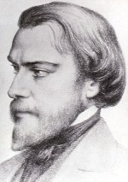
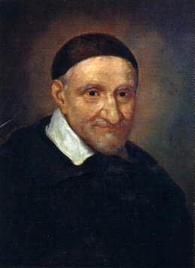
Purpose of this Training
Train Formators and Presenters to give the Ozanam Orientation
Provide you with the working knowledge to:
  Organize and conduct Ozanam Orientations
  Teach the material effectively
  Use the tools provided
  Develop a Council plan for Ozanam Orientations
  Participate in a Council Formation Committee

Slide 11
Objectives of this Training
Participants will be able to:
Describe spiritual formation in the society
Discuss the Vincentian Formation Guidelines
Provide an experience of education, training, and formation for new members of the Society
Notes:
Describe spiritual formation in the society and the strategic focus to provide ongoing opportunities for Vincentians to deepen their ministry
Discuss the revised Vincentian Formation Guidelines and describe roles and responsibilities of Formators, Presenters, and Spiritual Advisors in the Society
Briefly discuss different types of Formation, and how that applies to the Ozanam Orientation. (More detail on a later slide)

Slide 12
Objectives of this Training
Use the resources needed to present all sections of the Ozanam Orientation
Begin to develop personal stories and examples that bring the formational material to life in a way that is consistent with the established themes and objectives
Notes:
Use the resources needed to present all sections of the Ozanam Orientation
Make a commitment to present the Ozanam Orientation authentically, according to the National Resolution
Begin to develop personal stories and examples that bring the formational material to life in a way that is consistent with the established themes and objectives

Slide 13
What is Formation?
Vincentian Formation is the initial and ongoing process of growing and developing in the tradition, charism and spirituality of the Society of St. Vincent de Paul.
Vincentian Formation enables the fulfillment of the three essential elements of the Society:
  Spirituality, Service and Friendship
Notes:
Talk about the primary purpose of the Society: Spiritual Growth of Members
Begin to impress upon folks the incredible importance of the OO in setting the tone for the personal ministry of every Vincentian
Our Rule: Part 1, 3.12
It is essential that the Society continually promote the formation and training of its members and Officers, in order to deepen their knowledge of the Society and their spirituality , and to improve the sensitivity, quality and efficiency of their service to the poor…
Vincentian Formation is the initial and ongoing process of growing and developing in the tradition, charism and spirituality of the Society of St. Vincent de Paul. Initial and on-going formation touches the head and the heart of the members, assisting each one to find meaning and purpose in life, love and a sense of relatedness. Vincentian Formation thus enables the fulfillment of the three essential elements of the Society: Spirituality, Service and Friendship. (Vincentian Formation Guidelines, revised: April 2019)

Slide 14

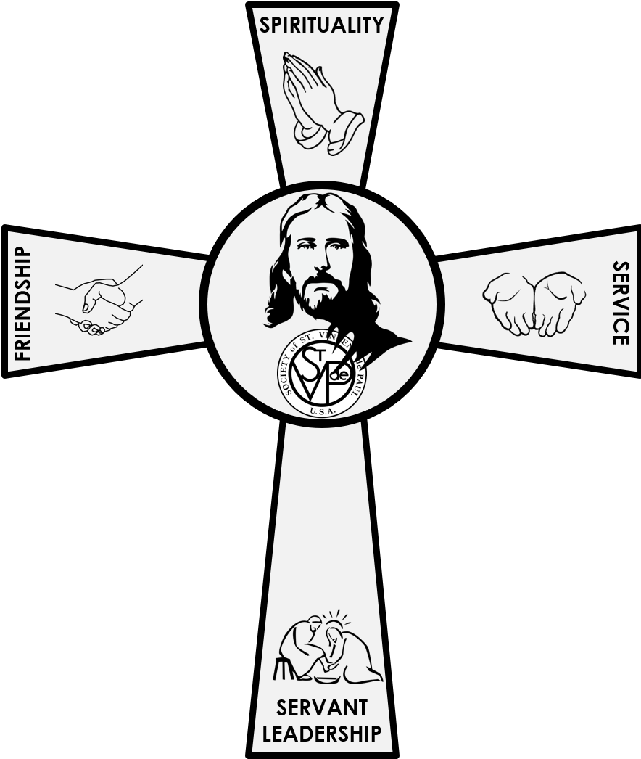
A Lifelong Process of Becoming
Human
Spiritual
Intellectual
Ministerial
Notes:
We are formed; we become “created anew!”
HUMAN – behavior, virtues, Aristotle
SPIRITUAL – also human! We are formed by relationships; trinity; we grow in holiness together.
INTELLECTUAL – study, reading, attending training (later)
MINISTERIAL – call to pastoral charity!

Slide 15




In Practical Terms
Formation
Formation
Formation
Formation
Notes:
Training
Study/reading
Prayer – individual, meditation, reflection together
Action!

Slide 16
Reflection 1
Some of our formation is positive and some is negative. But it is still formation.
Take a few minutes now to reflect on an event in your life that helped make you the person you are today.
Share briefly with the person next to you.
What was the event?
How did it “form” you?
Notes:
Suggest that this may have been an event like graduating from school (or dropping
out), or marriage, or the birth of a child, perhaps an illness or retirement.

Slide 17
Reflection 2
We are formed as Vincentians.
Take a few minutes to reflect on an event which led you to become the Vincentian you are today.
Share briefly with the person next to you.
What was the event?
How did it “form” you?
Notes:
It might have been someone you met on a visit.
It might have been by being taken advantage of and then
having to get past that to help others.
It may be the opening prayer you have said for
years at your meetings.

Slide 18
National Strategic Plan (2022-202?)
Focus Area II of the Strategic Plan calls the National Council to:
“Encourage and Support Vincentians on their Spiritual Journey”
2-1 Foster a greater sense of membership in the Society as a vocation
2-2 Identify and develop more versatile formators
2-3 Increase accessibility and opportunities for Vincentian Spiritual Formation
Coming: Ozanam Institute (related to Goal 2-2)
Notes:
Discuss this summary slide, in terms of the ongoing development of the focus on the growth in spirituality and the enhancement of the resources available.
Recognize and express appreciation that they will be a part of this strategic initiative, and the difference it makes in the Society
Finish by saying something like” “Let’s look at some of the specific goals and metrics”

Slide 19
Resources
Serving in Hope Modules: Formation guides and video resources
Spiritual Advisor formation and spirituality resources
National Ozanam Orientation Program, the basic formation program for all Vincentians offered to every active and associate member of the society
Notes:
In a ministry like ours, with a great diversity of members, resources that are readily available to Formators, Presenters, Spiritual Advisors and members is very important. Resources like…
Serving in Hope:
Module I: Our Vincentian Vocation
Module II: Our Vincentian Spirituality
Module III: Our Vincentian Heritage
Module IV: Our Vincentian Mission
Module V: Our Vincentian Rule
Module VI: Our Vincentian Conference
Module VII: Our Vincentian Home Visit…..

Slide 20
Resources
The Vincentian Pathway: the Vincentian Pathway is being offered as an opportunity for every Vincentian to engage in an on-going process of formation. This formation process is based on the Essential Elements of the Society (Spirituality-Friendship-Service) and Servant Leadership.
Vincentian Spirituality Resources for Spiritual Advisors and Formators available through the catalog at www.svdpusa.org
Notes:
The next few slides include specific resources available through the catalogue. The following resources are not listed, but can be assessed through the catalog. Encourage folks to explore www.svdpusa.org
Seeds of Hope: Stories of Systemic Change
II. SOCIAL JUSTICE TEACHINGS OF THE CHURCH RESOURCES
Compendium of the Social Doctrine of the Church; by the Pontifical
Council of the Social Doctrine of the Church : Order on Amazon.com
The website for the United States Conference of Catholic Bishops: www.USCCB.com Busy Christian’s Guide to Catholic Social Teaching: www.uscatholic.org
III. AMAZON: The following can be ordered on www.amazon.com :
St. Vincent de Paul:
Vincent de Paul, The Trailblazer, by Bernard Pujo.
Praying with Vincent de Paul, by Tom McKenna, CM
The Way of Vincent de Paul: A Contemporary Spirituality in
the Service of the Poor, by Robert P. Maloney, CM.
Go! On the Missionary Spirituality of St. Vincent de Paul, by Robert P. Maloney,CM.
Vincent de Paul and Charity, by Andre Dodin, CM.
St. Louise de Marillac:
Praying with Louise de Marillac, by Audrey Gibson, DC and Kieran Kneaves, DC.
Louise de Marillac: Social Aspect of Her Work, by Margaret Flinton, DC.
Louise de Marillac: A Light in Darkness, byKathryn LaFleur, SP.
Blessed Rosalie Rendu:
Sr. Rosalie Rendu: A Daughter of Charity on Fire with the Love of the Poor
by Louise Sullivan, DC
Blessed Frédéric Ozanam:
Ozanam, by Madeline des Rivieres
Frédéric Ozanam, by Mary Ann Garvey Hess
Praying with Frédéric Ozanam by Ronald Ramson, CM
Vincentian Spirituality:
Classics of Western Spirituality Series:Vincent de Paul and Louise de Marillac
Deep Down Things, by Richard McCullen, CM.
He Hears the Cry of the Poor: On the Spirituality of Vincent de Paul,
by Robert Maloney, CM.

Slide 21


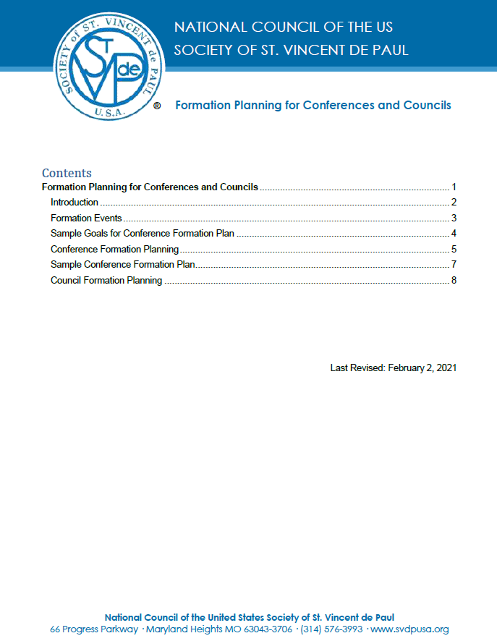
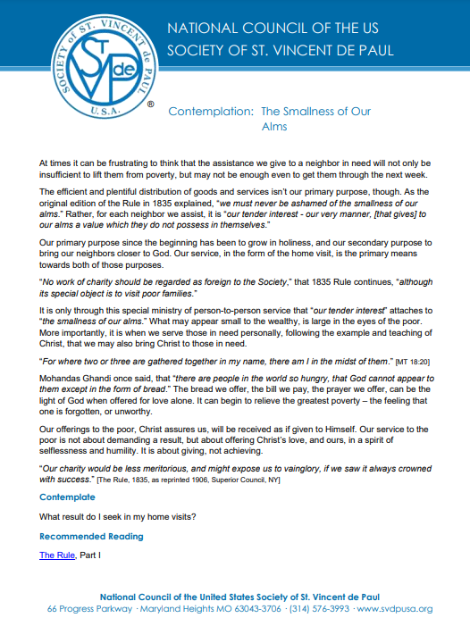
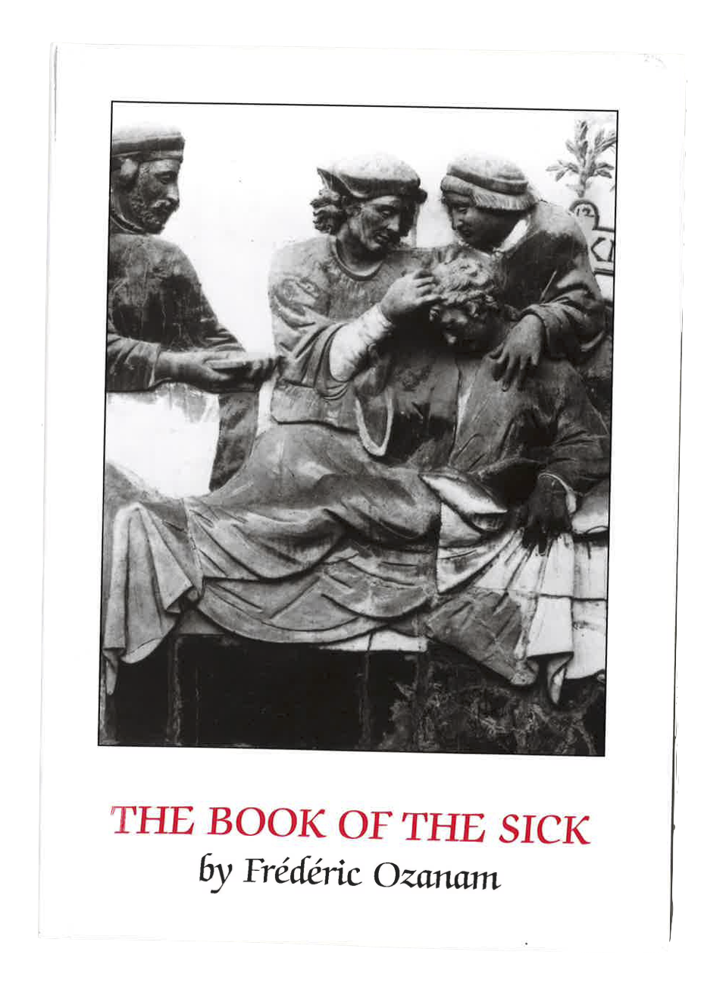
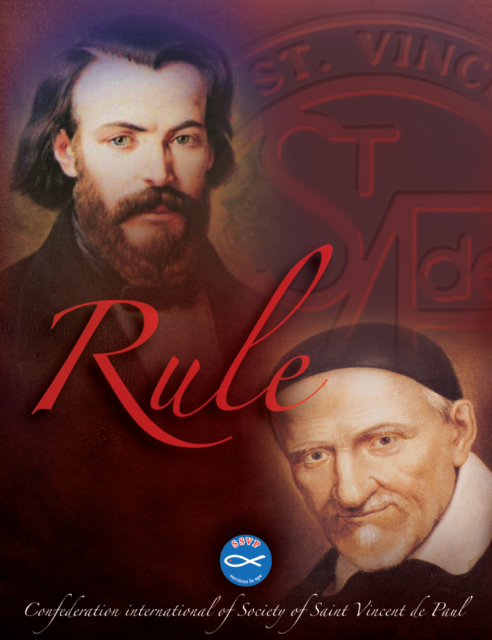
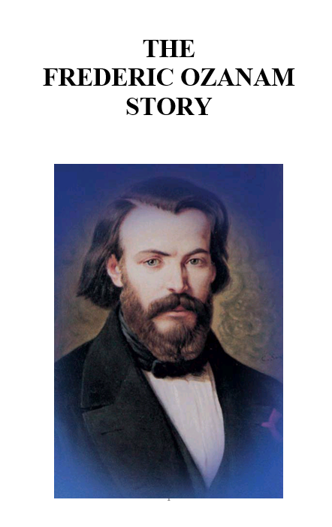

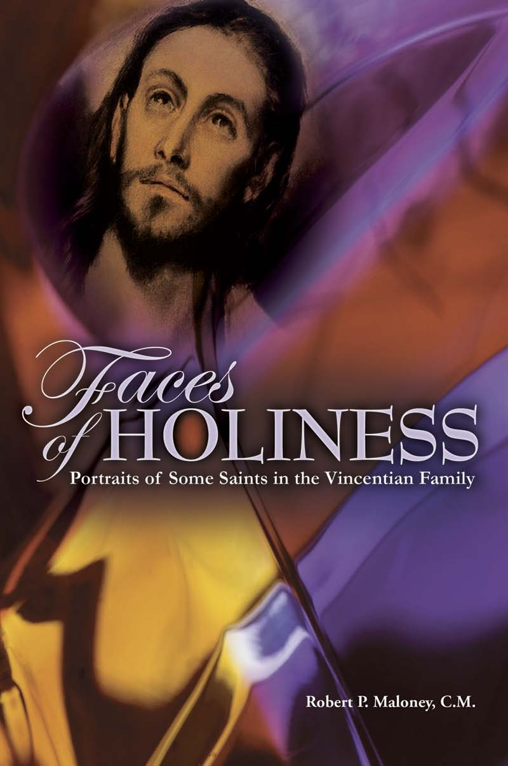

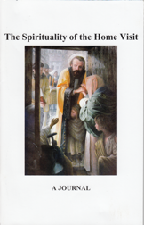
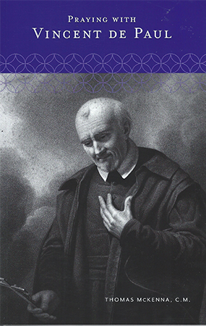

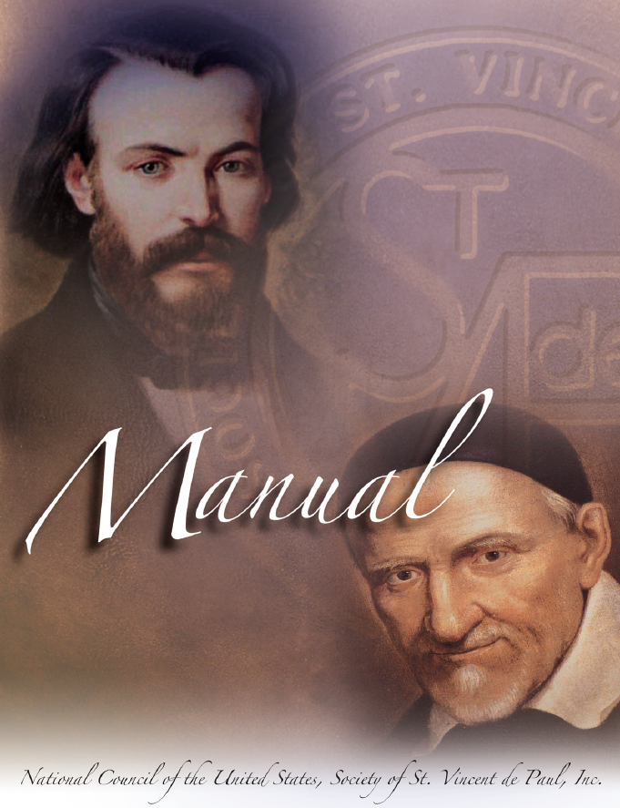

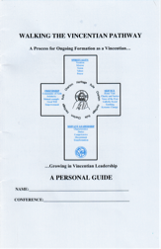


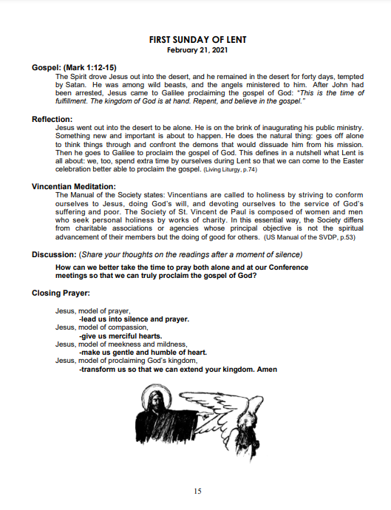


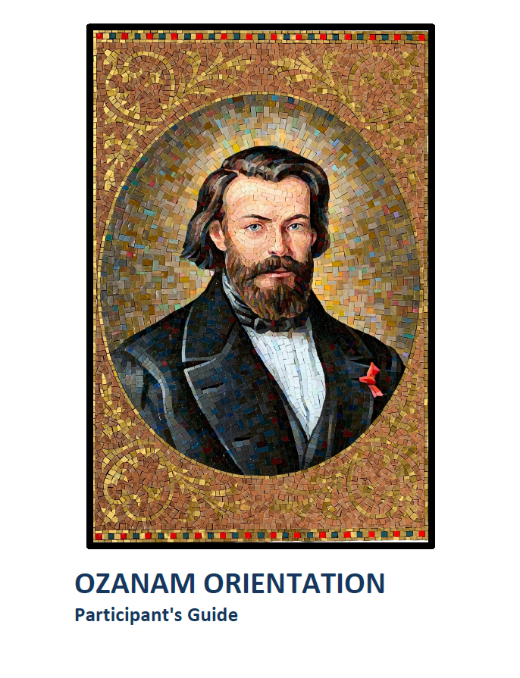
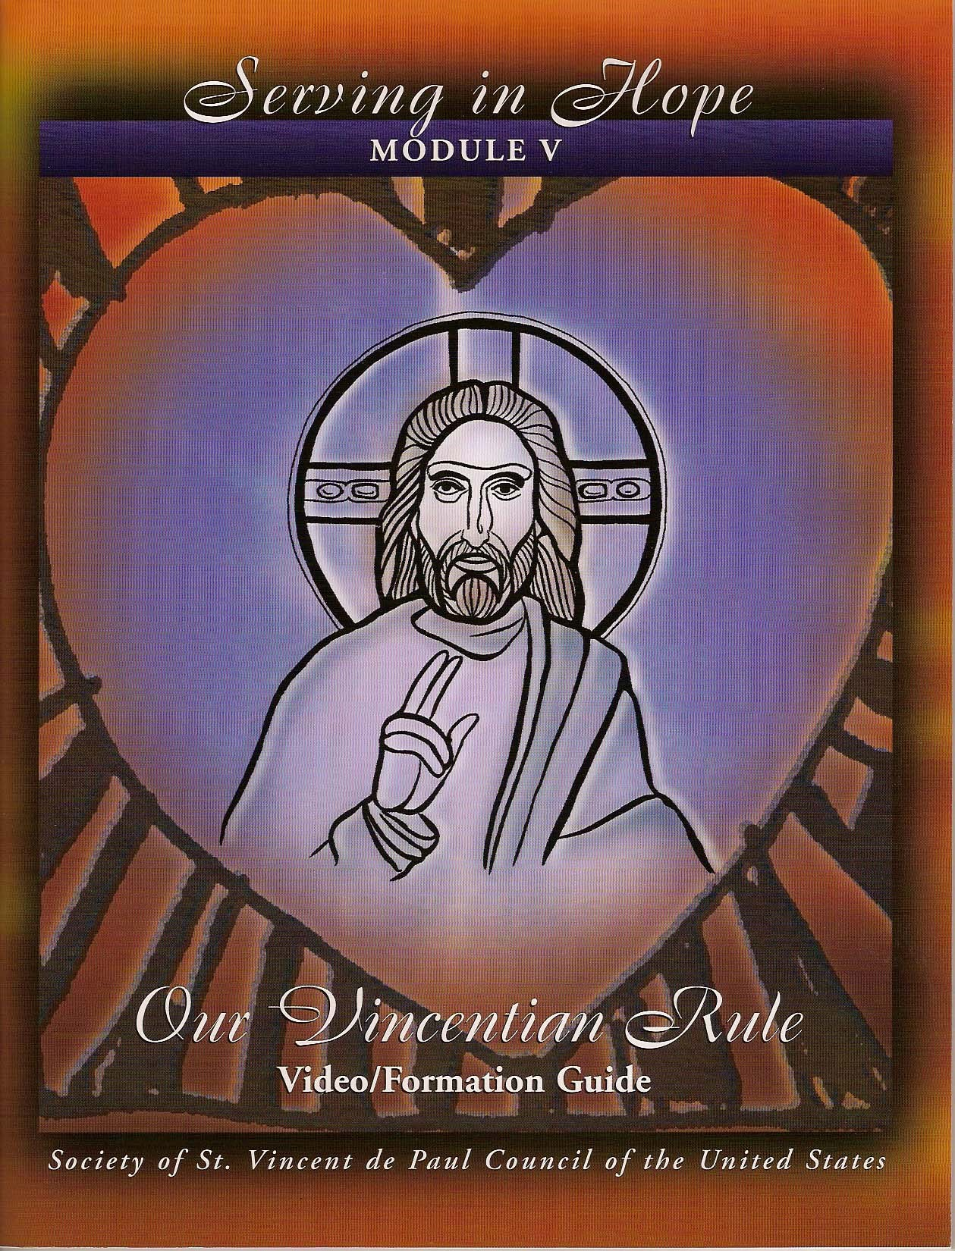


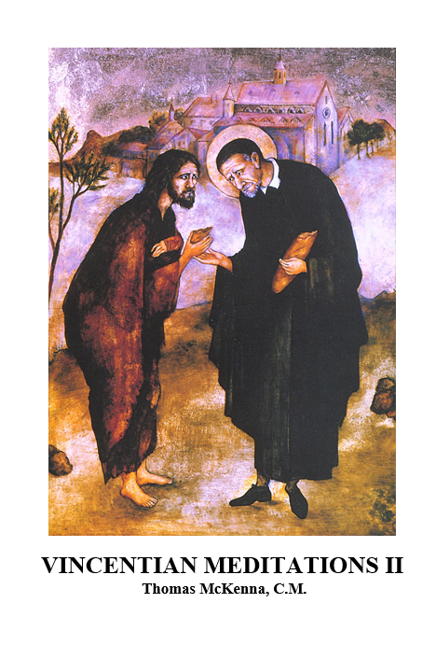




Formation Resources

Slide 22
Resources
National and Regional Committees offer workshops and resources:
  Systemic Change
  Voice of the Poor
  Diversity/Multicultural Issues
  Youth and Young Adults
Notes:
These committees inspire formational opportunities across the regions. Their membership consists of thought leaders across the Society.

Slide 23
National Formation Committee
Marge McGinley
Committee Chair
East
James Davis
South Central
Rita St. Pierre
Northeast
Terri Zenobio
Northeast
Catalina Miller
West
Gail Rowe
Midwest
Marty Cormack
North Central
Pura Santangelo
South Central
Ray Sickinger
Northeast
Tim Williams
Formation Director
National Office
Notes:
Brief review

Slide 24
National Spanish Formation Subcommittee
Marge McGinley
Committee Chair
East
Tim Williams
Formation Director
National Office
Guadalupe Sosa
West
Jacqueline De Leon
Northeast
Lalo Rodela
South Central
Notes:
Brief review

Slide 25
Partners in Formation
Spiritual Advisors working with Regions, Councils, Districts and Conferences
Rule, Part I, 3.13 states:
Members of the Society are united in the same spirit of poverty and sharing. They encourage one another to live a profound spiritual life and spirit of prayer. For this purpose, the role of SPIRITUAL ADVISOR IS VERY IMPORTANT

Slide 26
Spiritual Advisors
Spiritual Advisors are animators of the Vincentian Charism. Conference to Conference, Council to Council they promote “The Journey Together Towards Holiness”!!
  Commitment to the call and pursuit of Vincentian holiness.
  Value of lay ministry in the fulfillment of the mission of the Church.
Notes:
2.2 The journey together towards holiness
Vincentians are called to journey together towards holiness, because true holiness is perfect union with Christ and the perfection of love, which is central to their vocation and the source of its fruitfulness. They aspire to burn with the love of God as revealed by Christ and to deepen their own faith and fidelity.
Vincentians are aware of their own brokenness and need for God's grace. They seek His glory, not their own. Their ideal is to help relieve suffering for love alone, without thinking of any reward or advantage for themselves.
They draw nearer to Christ, serving Him in the poor and one another. They grow more perfect in love by expressing compassionate and tender love to the poor and one another.
Therefore, their journey together towards holiness is primarily made through:
Visiting and dedicating themselves to the poor, whose faith and courage often teach Vincentians how to live. Vincentians assume the needs of the poor as their own.
Attending the meeting of the Conference or Council, where shared fraternal spirituality is a source of inspiration.
Promoting a life of prayer and reflection, both at the individual and community level, sharing with their fellow members. Meditating on their Vincentian experiences offers them internal spiritual knowledge of themselves, others and the goodness of God.
Transforming their concern into action and their compassion into practical and effective love
Their journey together towards holiness will be all the more fruitful if the members’ personal lives are characterised by prayer, meditation on the Holy Scriptures and other inspirational texts and devotion to the Eucharist and the Virgin Mary, whose protection we have always sought, and to the teachings of the Church.

Slide 27
Spiritual Advisors
Importance of personal witness to living a spiritual life.
Importance of direct service to the needy and being a member of a Conference
Teachings of the Catholic Church including its Social Teachings.
Notes:
Spiritual Advisors promote the learnings from Ozanam and reinforce the content through reflections, workshops, and retreats
They tie this amazing ministry back to the Church’s call to the laity, established/reinforced by Vatican II, Baptism as the sacrament for ministry
They bring that personal witness to all meetings at the conference, district, and council levels and hold the space for the Vincentian Charism

Slide 28
Formator Roles
Regional and Council Formators
Ozanam Orientation Formators and Presenters

Slide 29
Council Formation Coordinator
Creates Council Formation Committee and Plan and Annual Report
Provides formation and training and assures Conference Spiritual Advisors for every conference in collaboration with Council Spiritual advisor
Ozanam Orientation Formator
Assures recruitment of Ozanam Orientation Formators and Presenters in collaboration with Council Ozanam Orientation Leaders
Offers ongoing formation for Systemic Change initiatives, Diversity, Advocacy, Leadership
Notes:
Selection:
Appointed by the Council President
Must be an Ozanam Orientation Formator
Will have a minimum of three years as an active member and a willingness to grow in an understanding of the:
Charism of the Society and Vincentian spirituality.
History, life and spirit of the Founders.
Programs of Vincentian Formation in the Vincentian Pathway (Attachment A).
Process of adult formation and the experience of working in groups.
Importance of communication and presentation skills.
Use of computers and other technology.
Willing to attend the Invitation to Renewal, when possible.
Responsibilities:
Create a Council Vincentian Formation Committee:
The purpose of the Vincentian Formation Committee is to create and implement a Council Formation Plan to promote the growth and development of the tradition, charism and spirituality of the Society of St. Vincent de Paul in the Council, Conferences and Special Works.
The Committee consists of the Council President, Council Formation Coordinator, Council Spiritual Advisor, a Conference Spiritual Advisor, and the Council Ozanam Orientation Leader. In addition to these members, other people with additional skill sets may become a part of the Committee.
Create a Council Vincentian Formation Plan:
Willing and able to travel to present the Ozanam Orientation.
Assure the recruitment and training of Ozanam Orientation Formators and Presenters
Assist in the organization of teams for Council Ozanam Orientations.
Provide formation and training of Conference Spiritual Advisors in collaboration with Council Spiritual Advisor
Offer on-going formation in Systemic Change, Diversity/Multicultural Issues, Advocacy, Youth, Young Adults and other Formation programs.
Assure an active, trained Spiritual Advisor for every Conference
Assure the Ozanam Orientation for all members.
Guide and teach the Vincentian Pathway. (Attachment A)

Slide 30
Council Ozanam Orientation Leader
Must be an Ozanam Orientation Formator
Trains and mentors OO Council Formators
Oversight of ordering and distribution of OO resources
Assures accurate list of OO Formators and Presenters and attendees entered into Nat’l Database
Submits annual report to the Regional OO leader
Notes:
Selection and Qualifications:
Selected by the Regional OO Leader, after consultation with the Council President.
Must be an Ozanam Orientation Formator
Will have a minimum of three years as an active member and a willingness to grow in an understanding of the:
Charism of the Society and Vincentian spirituality.
History, life and spirit of the Founders.
Vincentian Formation programs in the Vincentian Pathway. (Attachment A)
Process of adult formation and experience in working with groups.
Experience in communication and presentation skills.
Ability to work with technology
Ability to identify and develop candidates for Presenters/Formators
Willing to attend the Invitation for Renewal, when possible.
b. Responsibilities:
Train and approve OO Formators for the Council
Schedule, oversee and/or conduct Ozanam Orientations
Responsible for the oversight of ordering and distribution of OO Formation materials
Create an accurate list of Council Formators and Presenters and ensure entry into the National database
Ensure that Vincentians who have attended the OO are entered into the National database
Submit an annual report to the Regional OO leader with the number of OO’s in English and Spanish and the number of Vincentians completing the OO

Slide 31
Ozanam Orientation is the Foundation
The National Ozanam Orientation Program, the basic formation program for all Vincentians is offered to every active, associate and new member of the Society.
The Regional and Council Ozanam Orientation Formators train and Commission Formators and Presenters to conduct the Ozanam Orientation.

Slide 32
National Resolution - 2011
A Resolution to establish the Ozanam Orientation as required for new active members, all Officers, and Spiritual Advisors in the Society.
All new active members must attend Ozanam Orientation within one year.
All existing members of the Society should be required by their Councils to attend an Ozanam Orientation in order to reacquaint themselves with the “spirituality and heritage” of the Society and prepare themselves to enter the “Vincentian Pathway” process .
Notes:
A Resolution to establish the Ozanam Orientation as required for new active members, all Officers, Spiritual Advisors in the Society.
Whereas the Ozanam Orientation has been approved by the National Council as the program through which members are introduced to the Society, and
Whereas experience has proven the value of the Ozanam Orientation in preparing new and existing members of the Society to better understand the mission, spirituality, organization, history, Rule, accountability, strategic plan and home visitation aspects of the Society, and
Whereas the Society has now developed the capacity to present the Ozanam Orientation in all Regions and through the Regions to Councils and Isolated Conferences;
Therefore be it Resolved that the National Board of Directors recommends that the National Council require that:
All new active members must attend Ozanam Orientation within one year.
All existing members of the Society should be required by their Councils to attend an Ozanam Orientation in order to reacquaint themselves with the “spirituality and heritage” of the Society and prepare themselves to enter the “Vincentian Pathway” process .
The Ozanam Orientation should be taken before taking office, for all Council and Conference officers and Spiritual Advisors, but must be taken within one year after taking office. All Executive Directors are required to take the Ozanam Orientation within one year of being hired.
The effective date for this resolution is January 1, 2012.
The category of this Resolution is Formation and Training
Resolution number: 6/16/2010-11 93
Board of Directors Approved June 17, 2011
National Council Approved September 2, 2011

Slide 33

The First Step on the Pathway
SPIRITUAL
INTELLECTUAL
Ozanam
Orientation
Notes:
(Remember, “training” is a type of “intellectual formation”)

Slide 34
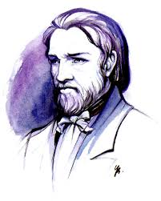
A Little History
“Visiting families is not as easy as it seems; instructions in this regard are extremely useful, and it would be good to repeat them.”

Slide 35
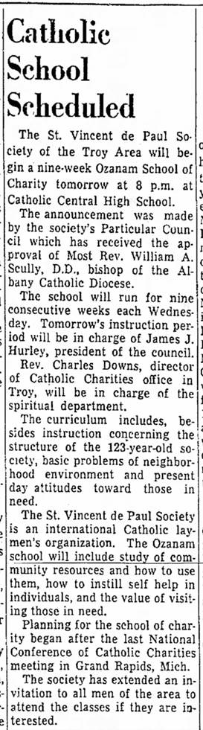
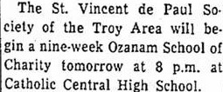
Ozanam School of Charity
Notes:
It used to be a lot longer!

Slide 36

Ozanam Orientation
2006
Ozanam Orientation Program Adopted
2016
Ozanam Orientation Major Revision
2010-11
Ozanam Orientation Resolutions 70 & 93
2020
Ozanam Orientation Updated

Slide 37
Ozanam Orientation is the Foundation
The Ozanam Orientation is taught by Formators and Presenters, who have overlapping but distinct roles
A Formator is responsible for the complete oversight of the Ozanam Orientation, is able to present all sections and has a willingness to pursue on-going knowledge of Vincentian spirituality and formation.
A Presenter is a person who is able to present a section or several sections of the Ozanam Orientation.
Notes:
The Ozanam Orientation is taught by Formators and Presenters, who have overlapping but distinct roles. To ensure an effective overall Orientation, at least one organizer must have significant understanding of all its content. This is the role of the Formator, who oversees the entire program and may also present one or multiple sections. The Formator is supported by Presenters, who have been trained to deliver one or more (but not all) sections of the orientation.

Slide 38
Formator Candidate Requirements
  A Vincentian for at least 3 years
  Active Conference Member
  Experienced in Home Visitation
  Effective Presentation Skills
  Comfortable with both lecture and dialogue
  Proficient with computers and technology
  Willingness to grow in knowledge and spirituality of the Society
  Able to articulate time requirements and expectations specific to their Council
Notes:
Candidate Requirements:
A Vincentian with normally 3 years of experience and approval of Council/Region
Attended an Ozanam Orientation (OO)
Effective presentation skills
Willingness to grow in knowledge and spirituality of the Society
Experience in home visitation
Proficient with computers and technology
Goal:
To prepare Ozanam Orientation Formators to competently present all sections of the Ozanam Orientation
Selection and Approval:
Formators are approved by the Council OO Leader.
Presenters are trained by their Council Formators
Formators should have the:
Capability to organize, schedule, and set up an Ozanam Orientation.
Ability to present all sections of the Ozanam Orientation.
An in-depth knowledge of the Society at the local, regional and national levels so that when a question is presented, they can answer the question accurately.
must have a willingness to pursue on-going knowledge of Vincentian spirituality and formation
Ability to develop skills of presenters and guide presenters to a better capacity for presentations if they need guidance.
Presenters should have
The capability to present one or more sections of the Ozanam Orientation.
Formators and Presenters must have a willingness to grow in an understanding of the:
Charism of the Society and Vincentian spirituality.
History, life and spirit of the Founders.
Program of Vincentian Formation.
Use of computers and other technology.
Responsibilities of a Formator:
Schedule and conduct Ozanam Orientation in conjunction or in collaboration with the Council OO Leader
Responsible for ordering and distribution of OO Formation materials
Ensure that Vincentians who have attended the OO are entered into the database
Some Formators have accepted responsibility for presenting other formation materials in addition to the Ozanam Orientation, such as training Spiritual Advisors, presenting Invitation to Serve, or conducting workshops on mentoring and the Home Visit, to name just a few.
This is you! You wouldn’t be here if someone had not already decided this is you.
When you, as a Formator, recruit presenters, you are looking for the same qualities.
Note to OO Coordinator:
This Formator Training is not intended to teach the participant public speaking skills, nor how to handle questions from a group, nor how to manage a group.
These skills cannot be taught in a one- or two-day session.
Vincentian leadership should recruit potential Formators and Presenters who already have those skills.
See also Formator Guide section on “Who Should Do the Presentation”. There is some great advice in there.
“Because a person has a great number years of service or has a great knowledge of the Society, that is no guarantee that s/he is a good public speaker. And not all good public speakers can nimbly handle questions. A priest may be called on every week (or even daily) to give a homily, but he may never have been called on to lead a discussion or teach a class.”

Slide 39
Presenter Candidate Requirements
  A Vincentian who has attended Ozanam O
  Active Conference Member
  Experienced in Home Visitation
  Effective Presentation Skills
  Comfortable with both lecture and dialogue
  Willingness to grow in knowledge and spirituality of the Society
  Able to articulate time requirements and expectations specific to their Council
Notes:
Presenters are trained by their Council Formators
Presenters should have
The capability to present one or more sections of the Ozanam Orientation.
Formators and Presenters must have a willingness to grow in an understanding of the:
Charism of the Society and Vincentian spirituality.
History, life and spirit of the Founders.
Program of Vincentian Formation.
Use of computers and other technology.

Slide 40
Qualities of a Good Presenter
A talent for formation as well as for training
Comfortable sharing their own stories and feelings
Can communicate a passion for the Society
Have the time and willingness to study
Able to improvise when the unexpected happens

Slide 41
Formator and Presenter Training
Led by the Regional Ozanam Orientation Leader and team
Must include substantial practice on the part of the participants, who will give sections of the Ozanam Orientation for each other.
Designed to meet the needs of both presenters and those that want to progress to Formator roles
The Ozanam Orientation Leader and team must observe the new OO formator presenting multiple sections in order to assess if the Objectives have been met
Notes:
Objectives: Upon completing the training, the participant will have:
An understanding of the distinction between formation and training, and how that applies to the Ozanam Orientation.
Basic knowledge of and commitment to Vincentian spirituality
Knowledge of the resources needed to present all sections of the Ozanam Orientation
A commitment to present the Ozanam Orientation authentically, according to the National Resolution (Attachment C)
Procedures for Training:
The Regional Ozanam Orientation Leader and/or Assistant Leader will present the Formator Training. (this can be done in person or via the web)
Formator training must include substantial practice on the part of the participants, who will give sections of the Ozanam Orientation for each other.
The Ozanam Orientation Leader may design the training to meet the situation and the needs of the participant.
Evaluation:
The trainer, or Ozanam Orientation Leader specifically designated by the trainer, must observe the new Ozanam Orientation Formator who is being trained presenting multiple sections in order to assess if the Objectives have been met. A live Ozanam Orientation program is preferred but not required.
The person in training is not considered to be a Formator until he/she has met the Objectives as assessed by the OO Leader.
A Commissioning ceremony and pin is highly recommended for both Formators and Presenters.

Slide 42
Formator and Presenter Training
In the South Central Region, the Regional Ozanam Orientation leader and team are willing to travel to the Council OO and observe/assess the new Formator and then Commission
The Ozanam Orientation Formator may train OO Presenters for selected sections of the Ozanam Orientation. Presenters can give sections as a member of a team under the supervision of a trained Ozanam Orientation Formator
A Commissioning ceremony and pin is recommended for both Presenters and Formators
Notes:
Procedures for Training:
The Regional Ozanam Orientation Leader and/or Assistant Leader will present the Formator Training. (this can be done in person or via the web)
Formator training must include substantial practice on the part of the participants, who will give sections of the Ozanam Orientation for each other.
The Ozanam Orientation Leader may design the training to meet the situation and the needs of the participant.
Evaluation:
The trainer, or Ozanam Orientation Leader specifically designated by the trainer, must observe the new Ozanam Orientation Formator who is being trained presenting multiple sections in order to assess if the Objectives have been met. A live Ozanam Orientation program is preferred but not required.
The person in training is not considered to be a Formator until he/she has met the Objectives as assessed by the OO Leader.
A Commissioning ceremony and pin is highly recommended for both Formators and Presenters.

Slide 43
Quote from Formator’s Guide
“All elements in each Part of the Ozanam Orientation are expected to be presented by the Formators. There are no optional items – no substitutions.
“This is necessary to ensure a consistent message is presented throughout the United States.
“The elements are also integrated in other segments of the formation program developed for the entire country, such as Serving in Hope and the Invitation for Renewal.”

Slide 44
I Want to Change the Slides…
You may include such things as
an ice-breaker
a spiritual reflection
more personal stories
another exercise
You may add slides with
local information
governance
more on the home visit
You may present in one 6-hour or in two 3-hour sessions.
You may not write your own custom version
Consistent slides => guest formators.
Consistent slides => Spanish handouts
Notes:
Speaker notes: We do encourage you to liven it up with your own exercise. Different formation teams are comfortable with different types of exercises depending on their backgrounds.
There’s about 10-15 minutes of buffer time for extra stuff, and of course you can go to 6.5 hours if you like.
You may add slides – but not so many that your formators cannot teach the standard version.
You may not change the text on slides
A few slides can be dropped in some situations – see Formator’s Guide.
(If someone asks or you know this is happening).
You may not replace a section with your own section.
If you are thinking of writing an entirely new section, please talk to the chair of the National Formation Committee Marge McGinley. svdpmcginley@gmail.com

Slide 45
Finding Your Team
Pray!
Ask District and Diocesan Council officers and spiritual advisors to help recruit
Look widely – formators do not have to be former officers
Look for people who have speaking skills
Look for experience with adult education; teachers, catechists, corporate or government trainers
Start with a couple of good people – a vibrant Orientation will attract others
Pray some more!
Notes:
Developing an Ozanam Orientation Team:
The Ozanam Orientation Formator may train OO Presenters for selected sections of the Ozanam Orientation. Presenters can give sections as a member of a team under the supervision of a trained Ozanam Orientation Formator.

Slide 46
Formators, Presenters, Spiritual Advisors, and Leaders
We all work together to provide the formational experiences that support the full flourishing of our Vincentians as they journey along the Vincentian Pathway….
Notes:
It takes all of us to animate the Vincentian Ministry, to follow in the footsteps of Jesus Christ , to imitate his outpouring of Love for our Brothers and Sisters in need

Slide 47
Servant Leaders Create the Expectation
All levels of leaders throughout the Society are Servant Leaders, dedicated to promoting Spirituality, Service, and Friendship
“Following Christ’s example, the Presidents at all levels of the Society endeavour to be servant leaders. They provide an encouraging atmosphere in which the talents, capacities and spiritual charism of the members are identified, developed and put to the service of the poor and the Society of St. Vincent de Paul. The President of the Conference or Council will have special responsibility for promoting Vincentian spirituality.”
(Rule, Part I, 3.11)

Slide 48
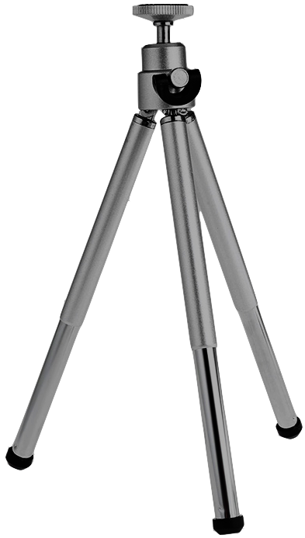
Organization
Healthy Overlap | Formation Tripod
Training
Formation
Spiritual Advisor
Formator
Spiritual Advisor
Lead Formator
Servant Leaders
Notes:
With this slide, focus on the formation tripod and the importance of a supportive servant leader…..Formators are essential as organizers and teachers, spiritual advisors as encouragers and animators, but the leader must bring focus and energy within the conference and council

Slide 49

Diocesan Formation Plan
Every Diocesan Council should have a plan to:
  Regularly conduct Ozanam Orientations within reach of every Conference
  Train enough Formators and Presenters to meet the needs of the Diocese
  Provide Spiritual Advisor training regularly
  Coordinate other training and formation
Notes:
A plan helps things get accomplished. It’s good to have the OO across the diocese so Vincentians don’t have to travel too far.
Teams of 1 Formator and 2-4 Presenters help with the scheduling so no one has to be at every OO scheduled.
In conjunction with the council president and council SA plan for regular trainings for District Councils and Conference SA. Assist with plans for commissionings, retreats, etc
Works also with systemic change chairs, VOP chairs, Youth and Young Adult and Diversity committees.
Regularly conduct Ozanam Orientations (next slide)

Slide 50


Conferences: Spiritual Advisor
And the Conference President!
“Special responsibility to promote Vincentian spirituality.”
Rule, Part I, 3.11

Slide 51
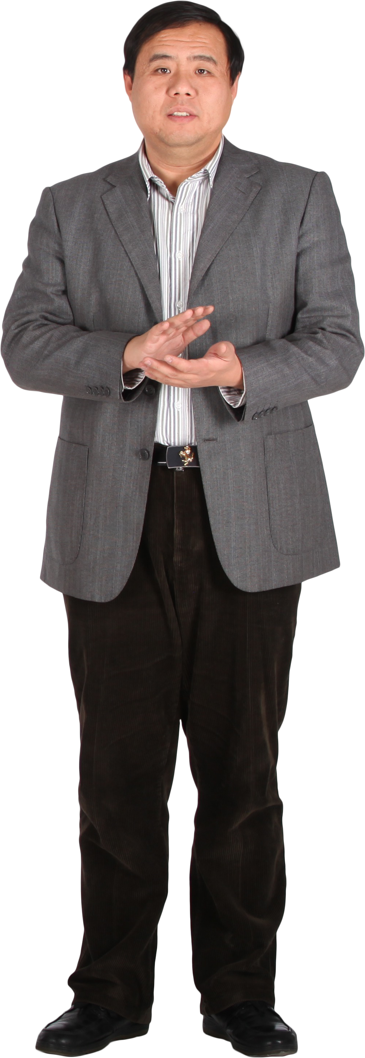



Councils: The Formation Committee
Formation Coordinator
Spiritual Advisor
Ozanam
Orientation
Leader
And the Council President!
“Special responsibility to promote Vincentian spirituality.”
Rule, Part I, 3.11

Slide 52
Show Us the Plan Already!
Formation Plans for Conferences and Councils

Slide 53
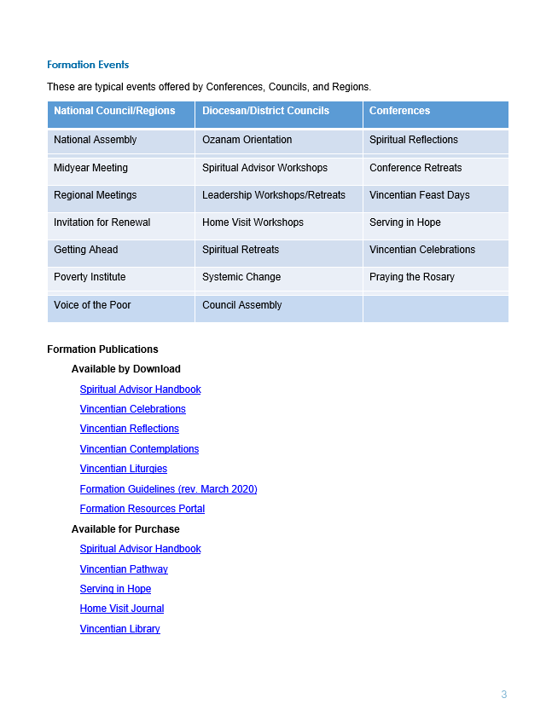
The What
Short list of priority resources
Linked for direct download

Slide 54
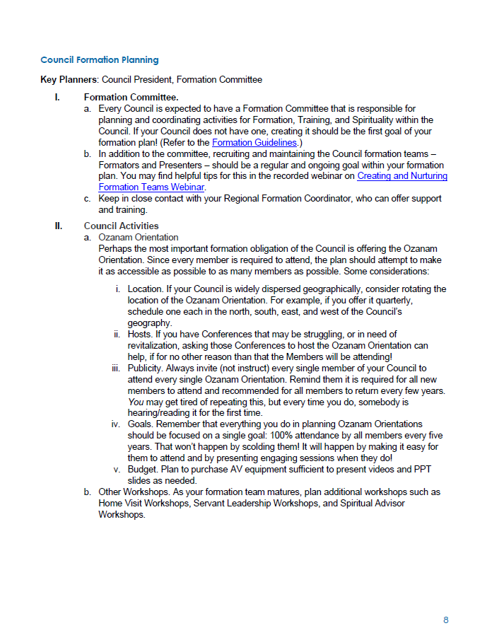
The How
The people involved
The steps to take

Slide 55
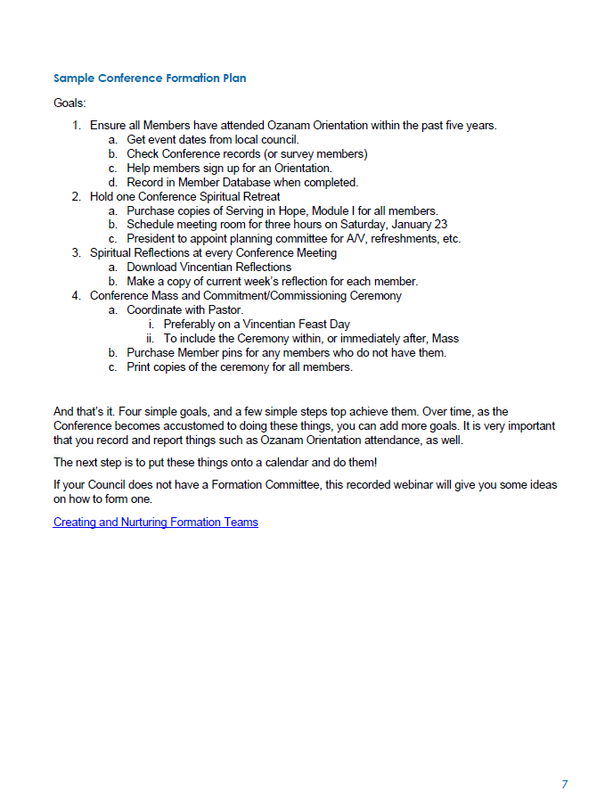
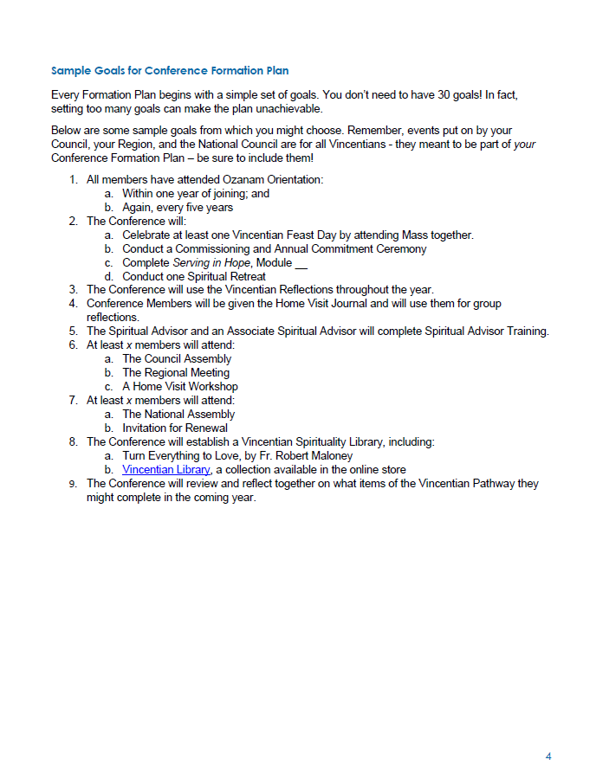
The Plan
Sample goals
Simplified Resource lists
Live links
Sample plan
  Goals
  Steps to achieve them

Slide 56
Example: Four Simple Goals
Ensure all Members have attended Ozanam Orientation within the past five years.
  Get event dates from local council.
  Check Conference records (or survey members)
  Help members sign up for an Orientation.
  Record in Member Database when completed.
Hold one Conference Spiritual Retreat
  Purchase copies of Serving in Hope, Module I for all members.
  Schedule meeting room for three hours on Saturday, January 23
  President to appoint planning committee for A/V, refreshments, etc.
Spiritual Reflections at every Conference Meeting
  Download Vincentian Reflections
  Make a copy of current week’s reflection for each member.
Conference Mass and Commitment/Commissioning Ceremony
  Coordinate with Pastor.
    Preferably on a Vincentian Feast Day
    To include the Ceremony within, or immediately after, Mass
  Purchase Member pins for any members who do not have them.
  Print copies of the ceremony for all members.

Slide 57
Obstacles to Formation Planning
Too Many Goals
Unrealistic Goals
Competing Priorities

Slide 58
Critical to Formation Planning
Dedication to Learning
Enthusiasm for Sharing
Prayer

Slide 59
Formation Plan
Willing and able to travel
Recruit and Train Formators and Presenters
Organize teams for Ozanam Orientations
Formation and Training of Conference Spiritual Advisors
Continued formation in Systemic Change, Diversity/Multicultural Issues, Advocacy, Youth & Young Adults, and other programs.
Guide and Teach Vincentian Pathway
Suggest Spirituality and Formation resources.
Conduct annual evaluation of Council Formation Plan and submit it to Region VP and Regional Formation Coordinator
Notes:
This looks like a lot of duties, right? So when you gather your team, encourage everyone to learn and be able to assist with each aspect. As you bring on new presenters, assign a mentor to work with them.

Slide 60
Our Local Plan
How often should we have Ozanam Orientations in our Council?
Where should we have Ozanam Orientations?
Considerations:
  Every member needs an opportunity to attend within one year of joining the Society.
  Reasonable travel time.
  It’s best to have multiple conferences at each Orientation.
  The Orientation is a full day. Saturdays are best.
  Don’t schedule when people have other things to do – Christmas, summer vacation, …
Notes:
Explain why the size and the multiple conferences are good.
A group of at least 10 but not more than 40 is a good-sized group. There is time for conversation and sharing. Having members from more than one conference also encourages sharing of best practices. We can all learn from each other.

Slide 61
Size of the Event
Orientation is designed for 10-40 people
  Ideally 3 formators & presenters
  At least 2
Fewer than 10: not enough to have good discussions
More than 40: difficult to manage the group and answer all the questions.
  Try to offer two Orientations instead of one.
  If you must have only one, allow at least 6 ½ hours
  You will need at least 3, preferably 4 or 5 Formators.

Slide 62
Determining the Need
How many conferences do you have?
Where are they?
Is there “pent-up demand”?
Do you have formators and presenters in each District Council so travel is less?
Come up with a rough plan which gives everyone an opportunity to attend an orientation in the next two years
  Groups of conferences who could “share” an orientation
  Cities or locations where you should have orientations
  Roughly when the orientations should occur

Slide 63
Consistency is Your Friend
Same version of the OO across your Council
  Formators help each other give the OO
  Vincentians move from one Council to another
  Spanish-speaking Vincentians
  Do make the OO personal
    Your own words
    Your own stories
    Local Information
    Additional exercise or ice-breakers.
Notes:
DO NOT stand up in front of the attendees and read the slides. They will read the slides and you as the presenter adds stories to make it pertinent.

Slide 64
Nurture Your Formation Team
Formators need to grow spiritually and continue to learn
  Encourage retreats and prayer life
  Offer to buy the occasional book or DVD for the formator
  Consider sending a formator to regional or national assemblies or Invitation to Renewal
Appreciate your Formation teams
  A thank-you note never hurts
Notes:
The Formation team should have a budget that allows for everything needed to present all the required trainings. A good suggestion is funding to begin a library. Share our library.

Slide 65
Creating a Plan – Formation Teams
Given that:
  It takes 2-3 people to put on an Orientation
  No one is expected to do more than 6 Orientations
  per year (most do 2 to 4)
Based on your plan, how many formators do you need?
Would it make sense to create teams of formators in different geographic areas?

Slide 66

BREAK

Slide 67
Planning the orientation

Slide 68
Where do I get materials?
From your Council Formation Coordinator, who orders them from National
You will receive:
  Flash drive containing all the materials described in this training
  Formator’s Guide (printed)
  Guidelines for Formators
Notes:
Formator's manual is also on flash drive in electronic form

Slide 69
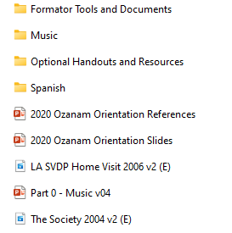
Formator’s Flash Drive
…
Notes:
The things you need to put on an Ozanam Orientation
Participant’s Guide PDF: It’s usually cheaper to order the Participant’s Guide from National, but if you are a few copies short, you can print your own.

Slide 70


Planning an Ozanam Orientation
Formator’s Guide PDF
  Same as printed copy
Orientation Checklist
  Prior to the Ozanam Orientation
  On the Day of the Orientation
  After the Orientation
  List of Supplies
Must-read documents:
  Vincentian Resolutions 070A and 093.
  Guidelines. These cover roles and responsibilities.
Notes:
Hand out copies of the checklist. It’s in “Formator Tools”

Slide 71
Other Handy Stuff
“French pronunciations” .mp3 – hear a native French speaker pronounce all those French names!
Optional slides showing a local council
Sample evaluation form
Template for Ozanam Orientation Certificate
How to print lots of certificates from a spreadsheet
Other helpful files
Notes:
We’ll go over this later in the class
They really must read the resolutions and guidelines.

Slide 72
Overview of the Orientation Day
6 hours, including 30 min lunch and two breaks
  Registration 8:45am
  Start promptly at 9:00am
  Finish at 3:00pm
Plan to stay at least 30 minutes after for questions
Orientation with 40 or more participants
  Registration 8:30am
  Start promptly at 9:00am
  Add 5-10 min each to lunch and breaks
  Finish at 3:30pm
Notes:
Registration ensures people will be in their seats at the start.
Some people will arrive 15 minutes early.
Also see Formator’s Guide. There is a wealth of useful information in the Guide, more than we can present here.

Slide 73

Scheduling the Orientation
Reserve room at least three months in advance
  Classroom, meeting hall, fireside room
Get commitments from formation team
Try to arrange a Mass before the Orientation
Work with the local people
  Involve the district councils in choosing dates and deciding which conference will host
  Try to get conference to run the sign-ups
Advertise, advertise, advertise!
Notes:
Securing a facility is the responsibility of the sponsoring Conference or (Arch) Diocesan Council. Those councils without their own facilities typically have a local Conference volunteer their parish facilities -- classrooms, meeting halls, etc. The facility must be available 1.5 hours before and 1 hour after the Orientation time.
Promotion and advertising are covered thoroughly in the Formator’s Guide
You’ll see in checklist that publicity is sent out multiple times.

Slide 74
Facilities
Let the hosting Conference know what you need.
Chairs and tables for small groups of 4-6 people
Padded chairs if possible
Equipment supplied by host:
  Projector & screen OR large (42” or more) TV
  Mic (optional)
  Podium (if desired)
Avoid excessive light
See Formator’s Guide for more details
Notes:
From Patricia Metrick. Also see Formator’s Guide.
Vincentians do not have the pure spirit existence of angels, so (a) temperature control, (b) comfortable [padded if possible] chairs, and (c) nearby restrooms are important. We need their minds as well as their bodies, and the friendlier the physical conditions, the easier this is to attain.
Typically, half the participants will complain it’s too cold and half say too warm. 70° to 72° is about right to have the group equally split. No one ever complains, however, about getting a padded chair instead of one all steel or plastic.
The seating arrangement should not be “theatre” style, but utilize tables, preferably round or square. People like to take notes, lean on their elbows, have a place for their coffee cup and a donut, or just spread out. Chairs should be set up on only one side of each table, else half the group will have to turn around to see and hear.
Some people hate podiums, but some trainers need them -- at least when they first start to make presentations,
Some people have voices they can project into an entire church, others need a microphone even for a small group.
Typically provided by the host, but could be provided by presenters: tables; registration, audiovisual, bookstore

Slide 75

Funding the Orientation
Decide who pays for what
  Lunch & snacks – usually host conference
  Funding for materials – usually Archdiocesan Council
    Participant’s Guide for each participant
    Rule & Manual for each household
    Handouts as desired
  Reimbursement for Formators’ gas or plane tickets and housing (if long distances are involved)
Should we charge a fee for an Orientation?
  Free is best
  Donation box is preferable to charging a fee
  If you must charge a fee, have scholarships
Notes:
Yes, you can use the donations of your parishioners to fund training. Training is a necessary part of running a responsible ministry, and our donors understand that we do have some overhead to fund such events.
Invite formators to stay with local Vincentians. It is a great way to make new friends!
Best to have a council-wide policy on who pays for what.
If you must charge a fee, also have a scholarship policy.
The preferred method is to ask for donations on the spot, rather than charge a fee.
Yes, you can use the donations of your parishioners to fund training. Training is a necessary part of running a responsible ministry, and our donors understand that we do have some overhead to fund such events.

Slide 76
Plan Your Handouts
Handouts on flash drive to use if desired
Most formators distribute at least these:
  Home Visit Prayers/Do’s and Don’ts of Home Visits
  Vincentian Website Locations
  Feast Days
You may add handouts of your own as well
Don’t forget evaluation form!
Hint: make a packet for each person: folder, binder clips, or stack papers together.
Notes:
Collected from different formators
Handouts can be made into a packet using binder clips, folders, or simply stacking them together.
If you have a large group, binder clips or folders are recommended.
Encourage use of the standard evaluation form, so you can compare apples to apples. The numerical scores are not usually useful, but the comments will help your Formation team improve. Normally, 10% to 15% of respondents will say this Orientation is too long (regardless of the actual length). If you are getting 25% or more such responses, you can improve. Consider whether your presenters are lecturing rather than speaking naturally, reading the speaker notes verbatim, or going too slowly.

Slide 77
Guide to Handouts
Think about your audience
Ask what the issues are
This will help you understand what to emphasize during the presentation
And which handouts will be most useful
A tour of handouts …
Notes:
Walk the students through the handouts available on the flash drive.
Your region or area may add handouts.

Slide 78

The “Bookstore”
If possible, have the following available:
  “Apostle In A Top Hat”
  Spiritual Advisors Handbook
  Conference President handbook
  Sample Serving in Hope Modules
  “Turn Everything to Love”
  Home Visit Journal
Works better to sell on the spot than to take orders.
Notes:
If you are providing a bookstore to sell on the spot, it is a project that takes extra planning which is not part of our Formator & Presenter training. It is just as effective to have a “show and tell” table and direct people to the National Council website to order books.

Slide 79
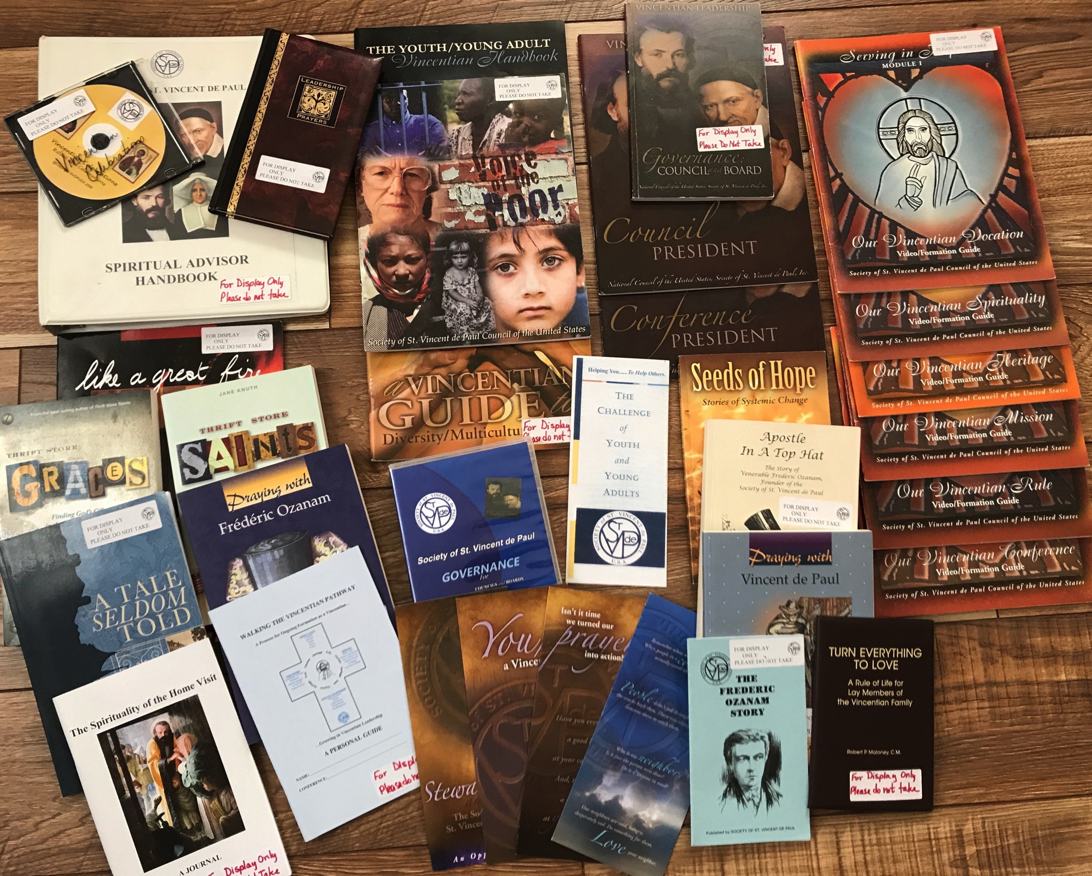
Sharing Resources

Slide 80
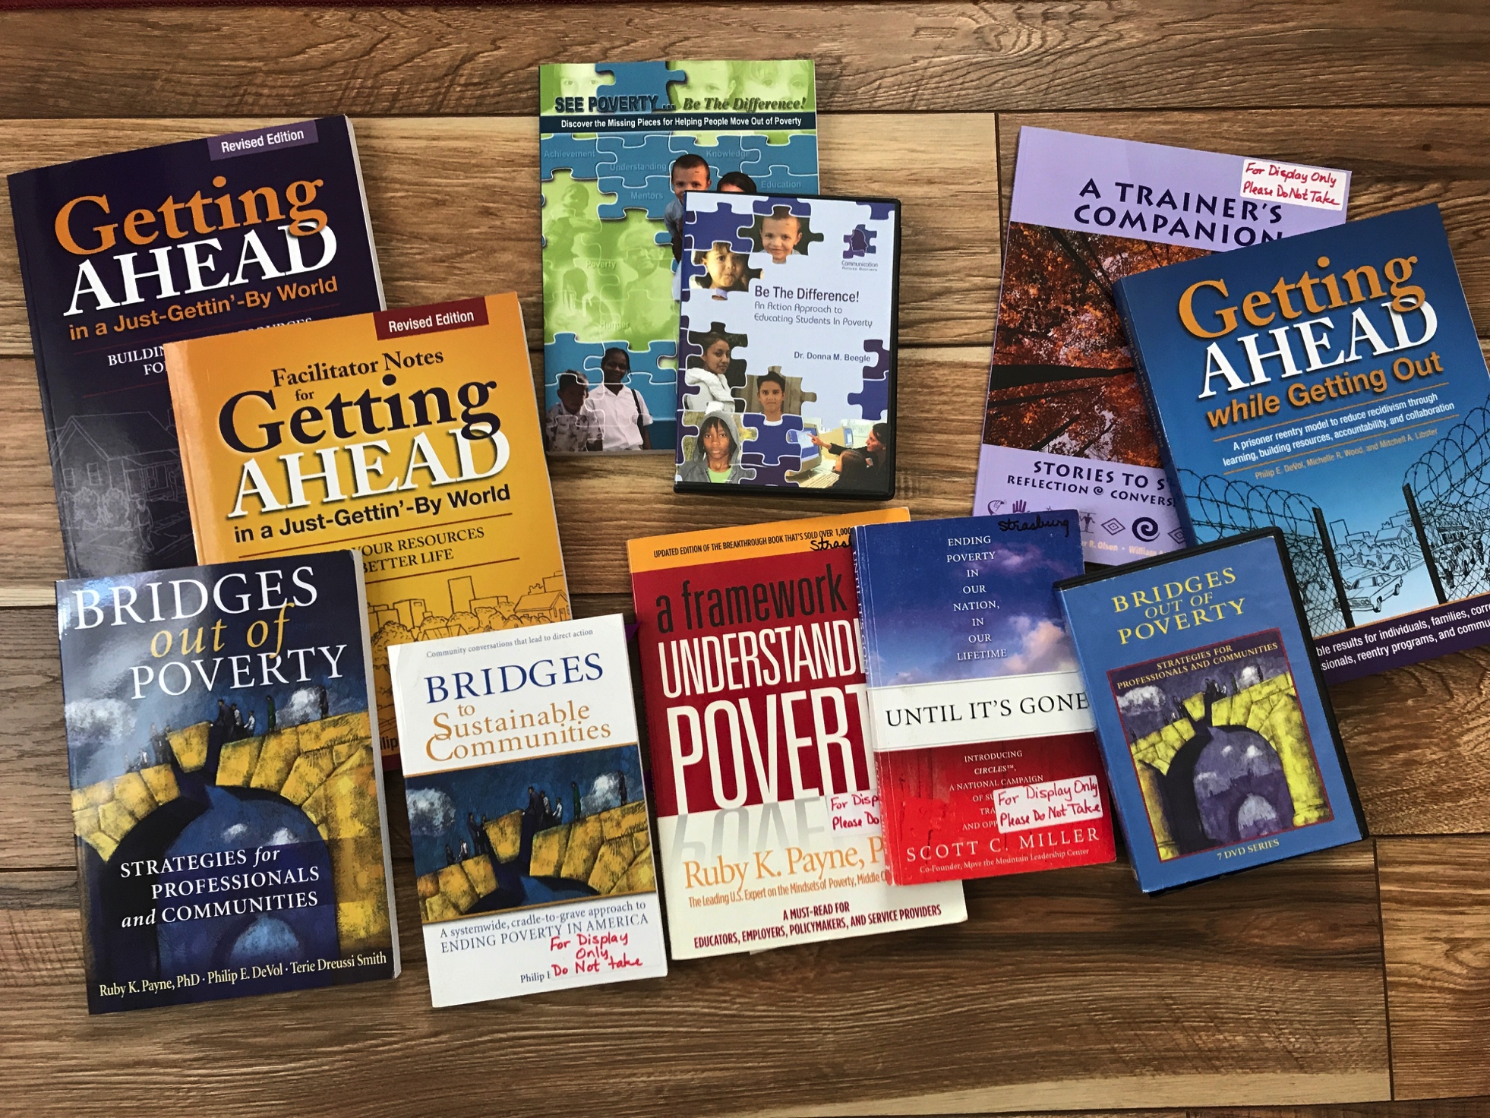
More Resources

Slide 81
Ordering from National
You must supply
  Rule & U.S. Manual – one per household
  Participant’s Guide – one per attendee
  (Consider the Participants Bundle in the store)
Order 3-4 weeks prior, 10% more than signups
Consider stocking:
  A few extra Rules, Manuals, and Participant’s Guides in Spanish & English
  Books you might want for the bookstore
Notes:
PDF on the flash drive in case you need extra Participant’s Guides.

Slide 82
Plan the Day in Advance
Plan your introductions
  Who introduces the OO (perhaps the president of the hosting conference?)
  Will the pastor will greet the assembled Vincentians, and when?
  How will participants introduce themselves?
  When to introduce your formation team?
  Who explains logistics – location of restroom, agenda, etc.?
Decide how and when to split up the participants into groups.
  “Count-off” for smaller groups.
  Groups of 40 or more may need more structure
If giving certificates, now or later?
Notes:
Trainer: The background for this slide is in the Formator’s Guide as stated.
Handouts can be made into a packet using binder clips, folders, or simply stacking them together.
If you have a large group, binder clips or folders are recommended.
Be sure to explain why you don’t hand out a detailed agenda.
Trainer: The background for this slide is in the Formator’s Guide as stated.
Handouts can be made into a packet using binder clips, folders, or simply stacking them together.
If you have a large group, binder clips or folders are recommended.
Be sure to explain why you don’t hand out a detailed agenda.
There are two main methods to form discussion groups:
Assign people to groups as they arrive by putting a group number on their Participant’s Guide or packet.
Assign people to groups at the first discussion group by counting-off.
For groups of 10-30, “counting-off” works best. Since you cannot predict exactly how many people will show up, pre-assigning groups can result in groups of 2 or 3 which is not enough for a good discussion. “Counting off” allows you to decide on the number of groups after you see how many people are there.

Slide 83
Spirituality
Maintain a spiritual approach throughout the day
Formation team: pray together before starting
Mass before or after the Orientation if possible
  If before, start Orientation 1 hour after Mass starts
Start with prayer, end with prayer
Don’t forget Grace Before Meals before lunch
Mid-day prayer after lunch
If the pastor visits, could he lead a prayer or bless the assembly?
Notes:
If possible, precede or finish the orientation with Mass.
If Mass is first, the Orientation “start” time is one hour after the start of Mass.
An alternative is to end the workshop with the 4:30 pm or 5:00 pm Mass of the parish.
Remember to stop and say “Grace before Meals” before breaking for lunch.
Pray with your formation team before starting the Orientation – and don’t be shy about letting people see you pray!

Slide 84
Before You Start
Set up early so you have time to greet people as they arrive
Place numbered cards for discussion groups on the tables
A packet of handouts for each participant
Don’t hand out detailed agenda.
Do tell people when lunch will be and when the day will end
In Formator’s Guide, see IV.A. “Starting the Day” pg. 27
and VIII.A. “Part 1: Introduction” pg. 38
Notes:
Trainer: The background for this slide is in the Formator’s Guide as stated.
Handouts can be made into a packet using binder clips, folders, or simply stacking them together.
If you have a large group, binder clips or folders are recommended.
Detailed agenda with times – people worry if you go over or under. They won’t worry if they don’t know about it. Tell them when lunch will be.
There are two main methods to form discussion groups:
Assign people to groups as they arrive by putting a group number on their Participant’s Guide or packet.
Assign people to groups at the first discussion group by counting-off.
For groups of 10-30, “counting-off” works best. Since you cannot predict exactly how many people will show up, pre-assigning groups can result in groups of 2 or 3 which is not enough for a good discussion. “Counting off” allows you to decide on the number of groups after you see how many people are there.

Slide 85
End of the Day
End with prayer
Thank the host Conference!
Thank people for coming
Offer to answer questions
Hand out evaluation forms at afternoon break
Notes:
The Ozanam Orientation should end on time, with prayer.
If you have time for Q&A, do so. If you don’t, invite people to stay after for Q&A. Honor the time limits.
Allow time for the evaluation form if you choose to use it.
A standard evaluation form is now included in “Formator tools”. We suggest you use this form because it allows us to compare results across time, across different versions of the Orientation, and across different places and types of groups.
The numerical scoring isn’t generally very helpful feedback.
The answers to the essay questions can be a great assistance to a formation team.
It is normal to have about 10% of the participants say the Orientation is too long. If you are giving the Orientation in 6 hours and more than 20% think it is too long, you should take a good look at what you’re doing, as it is likely your participants are bored or drifting off. Some of your presenters may need a little help in working with the materials.
Plan on staying at least 30 minutes after the Orientation to hear responses and answer questions. Some people may be bubbling over with new ideas that they want to share with you, and others will have questions that they didn’t want to ask in front of a group. Clean up can be done later, after participants have had their questions answered.

Slide 86
After the Orientation
Provide certificate of completion to all attendees
  Immediately OR later by mail
  Blank certificates & advice are on your flash drive
Be available to Conferences for on-going advice
  Willingness to attend Conference meetings to address concerns
  Make available the materials provided by National
Update National Membership Database if possible
  Each council/conference determines how this is handled
(Arch)Diocesan Council Formation Coordinator reports annually to Region, thence to National
  See Guidelines (on National Website)
  # OO, # participants
Notes:
Certificates can be provided at the end of the event. This requires
pre-printing certificates for everyone who is expected to attend
Pre-printing some blank certificates
Formator signs all certificates before the event
Additional attendees’ names are hand-written onto the blank certificates during lunch
Certificates can be provided later, to be presented by the Conference President to attendees with a bit of ceremony. This requires:
Getting a list of all attendees and their home Conference
Getting the name and address of the Conference President or the Conference office.
c) Printing, signing, and mailing the certificates (or handing them to presidents at a District Council meeting)
The latter method provides more publicity for the Orientation.
The former is quicker, although it can be logistically difficult if there is a large Orientation and only two people teaching.

Slide 87
Presentation tools

Slide 88
Your Flash Drive
Practice!
Copy the flash drive contents to your laptop.
If you accidentally erase a file from your laptop, where will you get a new copy?
Copy entire flash drive contents to your laptop
Videos may not run well from flash drive
You might lose the flash drive
Notes:
Stop and make students do this!
Make sure all the students have the right material and can easily find it.
Make sure they know where to get legitimate new copies.

Slide 89
Practice!!
Find files on your laptop
  A handout of home visit prayers
  The Ozanam Orientation certificate template
Can you easily find your folder?
Notes:
Use only if students are unfamiliar with laptops.
Home visit prayers – optional handouts
OO certificate – Formator Tools and Documents

Slide 90

The Mysteries of PowerPoint
You will need PowerPoint (Microsoft Office) if you don’t have it
The Ozanam Orientation is one large slide set.
There are several ways to move to the next slide:
  “Page Down” key
  Click with mouse
  Wireless remote control (like a TV remote)
  Allows presenters to move around. Price range $10-$30
Notes:
If they don’t have a copy of PowerPoint, they need to buy one. It is included in Microsoft Office.
If you don’t regularly use PowerPoint but will be the council formator, then the council might purchase a copy for your use.
You can decide if you want to advance slides yourself or if another presenter will do this for you. Be sure to have a sign to let them know when to move on. You may want to consider getting A wireless remote, so that you can advance the slides while moving around the room.

Slide 91
Running the Slides
Open your Formator Guide to page 32
Follow the instructions to
  Open the Ozanam Orientation slides
  Start in “slide show” mode
  Move to the next slide
  And the next slide…
Trouble? Raise your hand

Slide 92
Starting a Video
Go to page 33 in the Formator’s Guide
In your slides, go to the slide “The Society”
Start the video (it should start automatically by clicking to advance)
Trouble? Raise your hand
Notes:
You will need video troubleshooting guide – see next slide.
You will also need a flash drive with VLCPlayer install

Slide 93
Practice!!
Using Formator’s Guide as needed,
  Start the slide set
  Change slide set to “Slide Show” mode
  Embedded videos start and stop automatically
We will repeat until everyone is comfortable with this.

Slide 94
Practice!!
Open the errata file.
In the PowerPoint slides, go to slide #138 and make the change described in the errata.
Go to slide #123. Does anyone need help making this change?
If you’re giving the Understanding Poverty section, be sure to read the errata.
Notes:
Trainer: download latest Errata file from the National website and make available to students who need it.
(If they have an errata file on their flash drive, all of those changes are already incorporated into the slides on that flash drive)

Slide 95
Hardware and Software Needed
Formation Team
  Computer (Typically a Laptop)
  Microsoft PowerPoint 2000 or Later
  Optional – remote slide presenter (e.g. Logitech R4000)
  Powered Speakers for the Laptop
  Projector
  Male-Male VGA cable for Projector. Not USB cable.
  (projector should come with a VGA cable, but they get lost or broken...)
Hosting Site
  Access to a Sound System (if more than 30 People)

Slide 96

Your Orientation Box
Most formators put together a box or suitcase containing the items they use at a formation
  Laptop
  Signs
  Numbered cards to identify small group tables
  Pens & nametags for registration
  Spare VGA cable, power cord, HDMI cable, extension cord, power strip
  External speakers that work with your laptop.
  Blue tape (for the extension cord)
  Bookstore
  Etc.
Notes:
Blue painter’s tape will hold a cord down to prevent tripping, Try not to use duct tape as it leaves a sticky residue – forever.
I never assume any equipment will be available
Always ask ahead of time if the projector requires a VGA connection. This is rare, as VGA technology is quite old, and most computers don’t support it. You will need to do some research to see if you can find a laptop or adapter to support VGA.

Slide 97
Hints for Ozanam Sections

Slide 98
General Advice
Be yourself
  Speak in your own natural style and words
Don’t read the slides or speaker notes to the audience.
Know your material! Study the speaker notes and references.
Practice, practice, practice.
For those who have taught a previous version: check to be sure you have the newest materials and practice this version! If you don’t, you’ll run out of time.
In Formator’s Guide, see IV.C. “Presentation”
Notes:
Trainer: The background for this slide is in the Formator’s Guide as stated.

Slide 99
Managing the Group
Q&A – during or after the Orientation?
Don’t allow participants to derail the schedule
Circulate during the discussion groups
  Check that each group is giving everyone a chance to speak
  Be available to answer questions or provide more explanation
  Watch for groups with no natural facilitator
Notes:
Q&A during for small groups, if you can control.
Otherwise after and during discussion groups and breaks.

Slide 100
Learning Objectives
Learning Objectives: explicit statement of what participants should learn during this section.
Speaker notes of first slide in a section contains the section’s Learning Objectives.
Provides guidance for formators:
  What participants should take home
  Whether section is mainly Formation or Training
  What is the most important content
  What you don’t need to cover
Notes:
-- learning objectives have been added for the benefit of the formators
-- explain what a learning objective is – it’s from education
-- a learning objective states what we expect the participant to learn (not the same as what we intend to cover)
-- the objectives help you teach by
-- providing a target for you to focus on
-- lets you know what you *don’t* need to cover – easier to stay on time

Slide 101
References
Mission Statement: Manual, pp. 50-51; Serving in Hope Module I, pp. 37-39
Purpose and Scope: Rule Part I, Statute 1.3
Essential Elements: Rule Part III, Statute 1; Serving in Hope Module I, pp. 25-29
Core of the Society: Manual p. 23
SAMPLE
Notes:
References are collected at the end of each section instead of the little blue boxes. Easier to read in the participant’s guide.
(and frankly, easier for the authors)
Lets Formator know what he/she should read to prepare for teaching the section.
Point out the resources after each section
Encourage familiarity with the Rule and Manual
Don’t recite every resource on the slide

Slide 102
What If I Don’t Know?
You don’t need to know everything
Accuracy is important
If you don’t know the answer, just say so
Offer to provide the answer later after looking it up

Slide 103
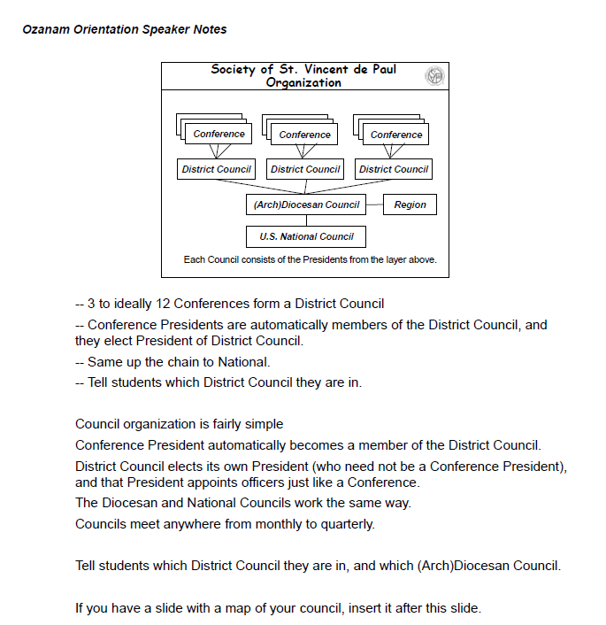
Typical Speaker Notes
Pg. 138
The points you must cover
Outline of suggested text
Suggestions for the formator
Notes:
Bullet points – you must cover these
Text – use it, or paraphrase it, or do your own.
Suggestions for formator – tips from experienced formators.
Printed in formator’s guide directly from PowerPoint slides, so the Formator’s Guide is identical to the PowerPoint slides.

Slide 104
Revised Formator’s Guide
All the good advice from past years plus…
New section on “Using Your Computer”
Section-by-section advice for formators
Miscellaneous advice
  Split-day Ozanam Orientation
  Mixed Spanish/English Orientation
  Which slides can be skipped & when
  Adding your own activity
  Other tools on your flash drive
Notes:
Using your computer – Navigation and starting videos, trouble-shooting
Section-by-section advice, which we will go over in a minute
Miscellaneous: Skipping slides: there are a few which aren’t relevant in some Orientations. These are spelled out in the Formator’s Guide.

Slide 105
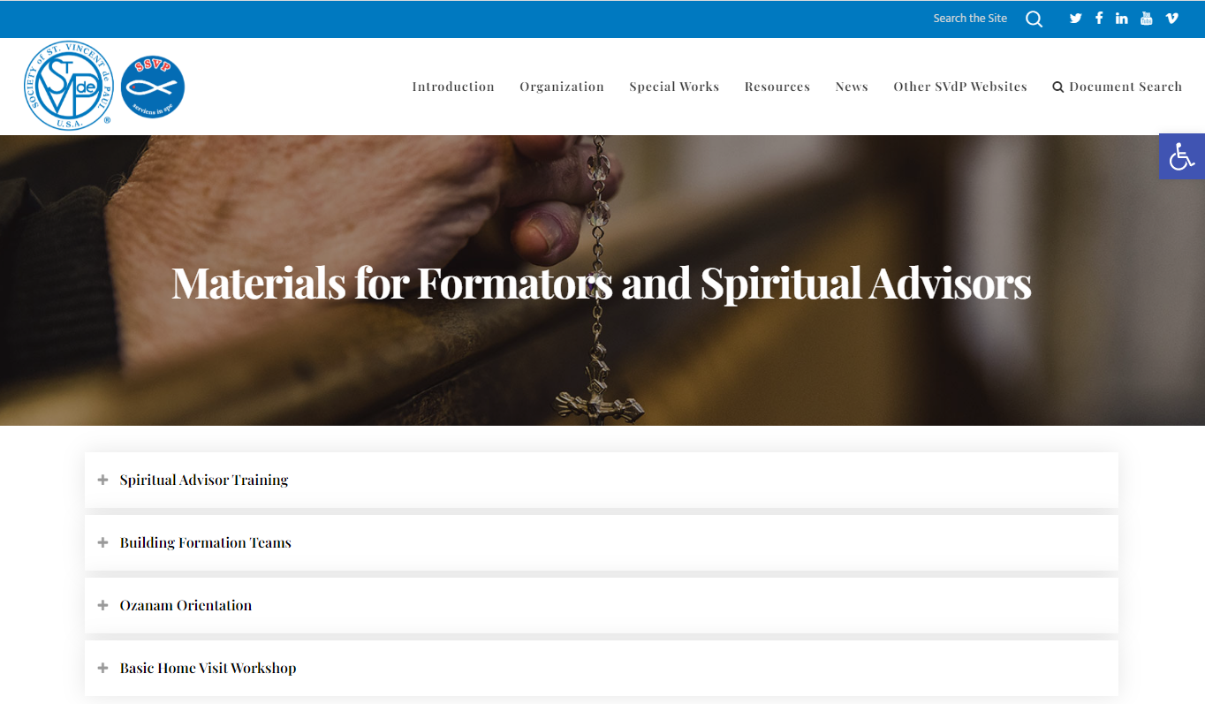
Now on National Website
In the Ozanam Orientation folder you will find:
The most recent errata.
Direct links to purchase books needed for OO
And more!
https://members.ssvpusa.org/formation/formation-resources/formators-spiritual-advisors/
Notes:
SPECIAL NOTE: If your flash drive contains an Errata file, all of those changes have already been incorporated into the files on the drive. Check the date on the errata file online, and only download if it is newer than the one you already have.
SPECIAL NOTE 2: The Video Troubleshooting Guide is still available, but it is very outdated and unlikely to help unless the presenter is using an extremely old computer and operating system.
If anyone asks – National will not be distributing the contents of the Ozanam Orientation drive via the Internet. Councils or Regions may distribute electronically only to their own formators, and only if they have a current list of formators and can ensure that only formators have access. National does not have a list of formators – this is the responsibility of Region and Council.

Slide 106
Closing Prayer
The best I can offer you God is the excellence of my work. Is this the most important thing I am supposed to be doing? Am I moving in the right direction? Am I doing it in a way that pleases you? My work adds nothing to your blessings, but your blessing means everything to my work. Help me know the difference between blessing and success. Amen.
Help me know the difference between success and blessing.
Richard Kriegbaum
Leadership Prayers

Slide 107
Day 2 Opening Prayer
Leader: The Vincentian servant leader cultivates a deep commitment to listening intently to others and seeks to identify the will of the group and helps to clarify that will in the context of the Vincentian value structure and Rule. And so we pray:
Alternate Sides:
It seems like nothing happens silently among us, God; everything requires words. My leading seems to be mostly words: the words that I hear or read and the words that I speak or write.
To do things differently, we need ideas, and the ideas need just the right words. Oh Lord, give each of us the good words and the good listening we need as servant leaders.
Help me listen to your Spirit so I will be able to listen to the unspoken messages people bring to me. Make me genuinely accessible. People come with their words, but they hope I will hear their hearts.

Slide 108
continued
  - Whether they speak or write, teach me how to be truly quiet inside and actively listen. I want to really listen and understand their hearts. Help me open my mind and heart. I cannot be a good servant leader if I cannot listen well.
Together:
I want my words for others to be your words for me. I need your Spirit to shape my thoughts so that when I express who I am as a servant leader, I will be your servant doing your work with your words. Speak to me, and speak through me. Let me listen to the words of their spirits. And let me speak words from your Spirit. Amen
Sr. Kieran Kneaves, adapted

Slide 109
Part 1 – Introduction
What: Partially formation, partially training
Who: Usually the leader of this formation team
2020 intro is meant to be dramatic
Opening prayer is in the section
Don’t try to cover the entire mission statement – touch on the parts which speak to you.
“The Society” video has been shortened
  Removed the outdated strategic plan
  Couldn’t remove outdated numbers
In Formator’s Guide, see IV.A. “Starting the Day” pg. 27
and VIII.A. “Part 1: Introduction” pg. 38
Notes:
Partially formation – opening prayer, stress the spiritual aspect of the society.
It is dramatic.
This is the only place where the formator reads the slides – we are reading them for the benefit of those who cannot see well.
Read slowly and dramatically.
Read more about how to give the section in the Formator’s Guide. You’ll want to go over the Formator’s Guide as a team.

Slide 110
Your First Small Group Discussion
Counting off:
  Count participants present
  Divide by 4 or 5
  Everyone counts off to that number
  Ask everyone to move permanently to their table
  (make exceptions for those with mobility issues)
Discussion often becomes “getting to know you”
  Fine in this first discussion period
  Later, remind people to stay on topic
In Formator’s Guide, see IV.B. “Guided Discussions”. Pg 28
Also see Orientation Checklist.
Notes:
The class might want to share observations on guiding small group discussions in large and small Orientations.

Slide 111
Part 2 – The Story of the Society of St. Vincent de Paul
What: Formation
Who: your liveliest presenter.
Read your sources, especially for the stories:
  Vincent’s conversion: Serving in Hope Module I – Our Vincentian Vocation. Section 3, p. 22.
  Founding of the Society – Manual, p 83 or Apostle in a Top Hat.
  Sister Rosalie. Manual p. 87.
Choose which parts to give as a story.
Play the “French Pronunciations” video to hear how the French names should sound.
In Formator’s Guide, see VIII.B pg. 39 “Part 2: The Story”
Notes:
This section is much more formation than training. We want to open the participant’s hearts and minds to our fundamental principles and beliefs, through the human stories of our founders. Tell it as a story, not as history, and try to make the people come alive.
Look for a presenter who is lively and feels strongly about the story. In English, typical English story-telling techniques can be employed: “Once upon a time”, events in chronological order, repetition, using quotes or dialog.
The French names can be a stumbling block. In the “Julian Spiewak” video, a native French speaker pronounces some of the key names.

Slide 112
A sample story
We have a great story!
There are two stories in the Formator’s Guide as examples – pages 40 - 41
Make the story your own
This is how I tell the story of…
Notes:
Trainer: You may want to demonstrate one of the stories in the Formator’s Guide or your own personal favorite.
Give the story (with slides) as you would in an Orientation.
Ask the students to identify the story-telling techniques which you used.

Slide 113
Part 3 – The Gift of Vincentian Spirituality
What: Formation
Who: Someone who is passionate on this topic and is comfortable sharing their own Vincentian spirituality.
This section is crucial – give it the time and care that it deserves.
The concept of the Society as a SPIRITUAL group will be new to some attendees.
In Formator’s Guide, see VIII C “Spirituality” pg. 41
Notes:
This section is crucial – give it the time and care that it deserves. Remember that the concept of the group as a SPIRITUAL group will be new to some attendees. We need the feeling, not just the facts.
The best presenter is someone who is passionate on this topic and is comfortable sharing their own Vincentian spirituality. The presenter must be willing to share at least one personal example.
It is critical that the presenter stay focused on Vincentian spirituality. The focus here is “seeing the face of Christ in the poor.”

Slide 114
Part 4: Conference Life
What: Mostly training
Who: A current or former Conference President is nice
  Members are the Conference. They need to know:
    Why we do what we do: essential elements and principles
    Rules & guidelines – even the ones they’re not following.
    Accountability to avoid legal and tax problems.
    Recruiting is everybody’s job.
  This is a key section for new and revitalizing Conferences.
In Formator’s Guide, see VIII.D. “Conference Life” pg 41
Notes:
This section is mostly training rather than Formation.
A current or former Conference President is a good choice as presenter, since there are often questions.
If you have not already given each household a Rule and a Manual, do it now!
On some slides, you’ll be citing rules which you know are not followed by some of the attending Conferences. (e.g. meeting frequency). Don’t skip the rule even if it’s a sore point. If you know about a serious discrepancy, read up in advance in the Rule and Manual so you know why that expectation exists.
Why not just do all this training separately for officers only?
A Conference runs much more easily if all the members have some idea of how a Conference is run. While we don’t want to delve into details endlessly, we want participants to leave with a general understanding of how things work.
Also, today’s member is tomorrow’s president!
Don’t skip the diversity/recruitment slides. A welcoming Conference is created by all the members together, not just the officers.
All that said, there is a little trimming possible if the officers attend separate, mandatory training. See Formator’s Guide.

Slide 115
Part 5: Council Life
What: Mostly training.
Who: A current or former Conference or Council president if possible.
If possible, add a slide showing your own Council.
See speaker notes and Formator’s Guide for questions which often come up in this section.
Read the “Cultural Change” handout before giving this section.
In Formator’s Guide, see VIII.E. “Council Life” pg. 42
Notes:
Mostly training.
Note that there are some sample Council slides on the flash drive, under “Formator Tools”
Major issues are sometimes raised during this section. Allowing a few minutes to talk through something a council is struggling with may be ok, but more than 5 minutes will put you badly behind schedule. Ask the participants to check with you during lunch, a later break, or after the OO.

Slide 116
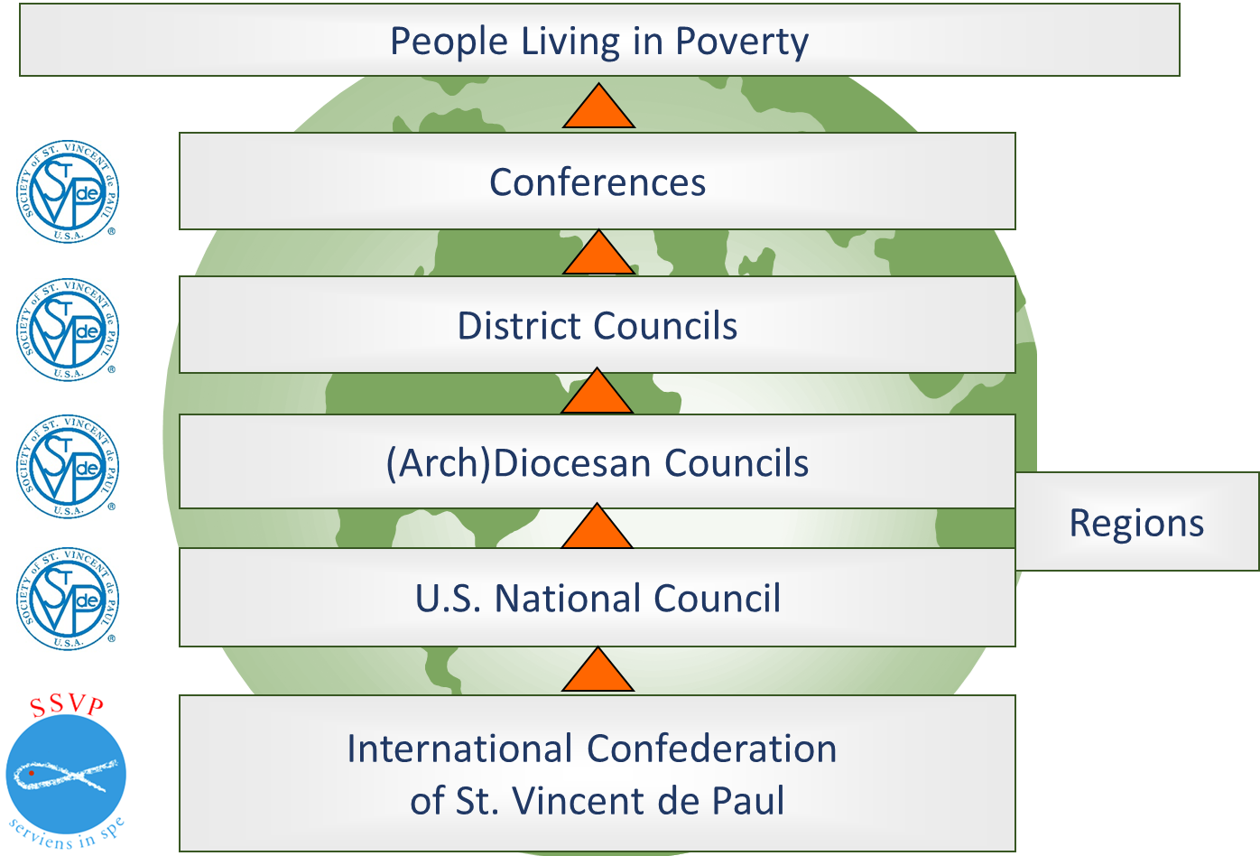
“Upside-down” Structure
Notes:
Both Conference Life and Council Life emphasize that our structure is to serve the Conferences.
This section focuses on how the levels of Councils serve the Conferences, and what each level can ask or expect of the level above (or in this picture, below it).
The formators and presenters should make the examples locally relevant whenever possible.
Regions or Diocesan Councils may want to add a slide or two about what they provide to their Conferences.

Slide 117
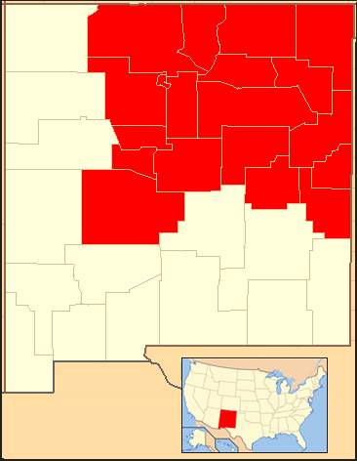
Archdiocesan Council of Santa Fe
6 District Councils
51 conferences
4 isolated conferences
By Croberto68 - Base map used: File:New Mexico Locator Map with US.PNG, CC BY-SA 3.0, https://commons.wikimedia.org/w/index.php?curid=9025601
Notes:
People love to see themselves. Include a local slide if possible.

Slide 118
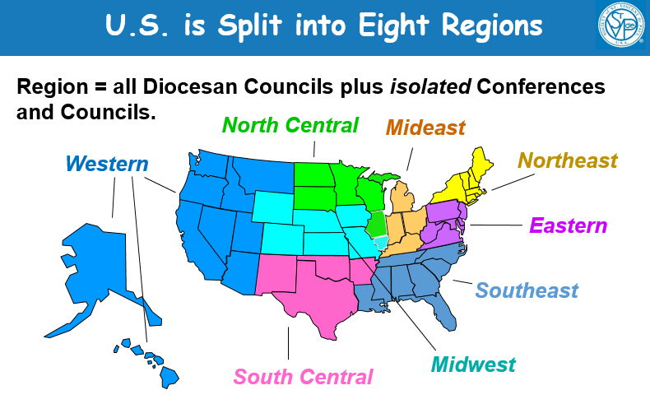
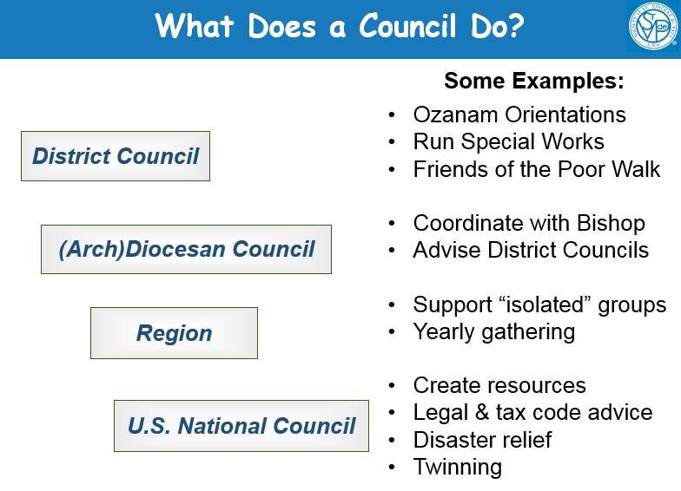
Audience Participation!
This section can be a bit dull. Get people involved!
Point to each state in your region and ask participants to call out its name.
Ask participants to name some things their district council does, then go through the list.
Ask local Council President to present a slide or two on what the Council does.

Slide 119
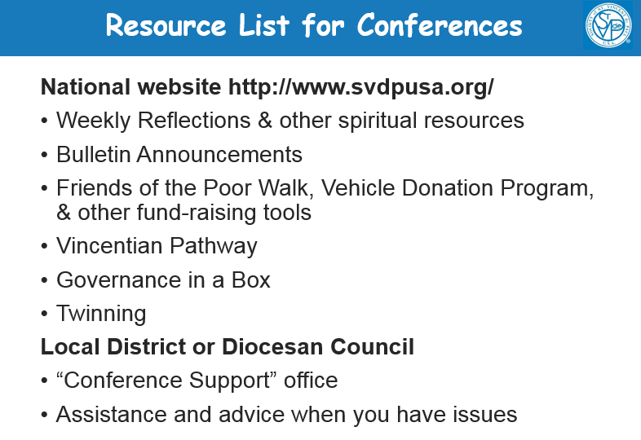
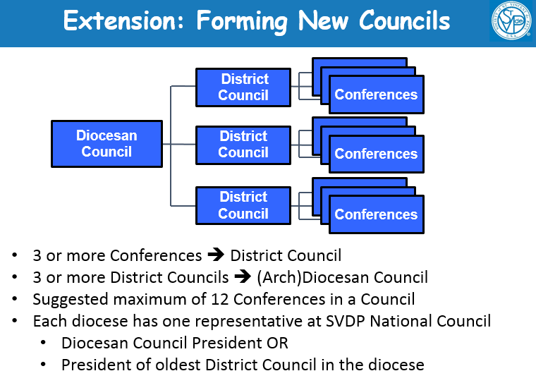
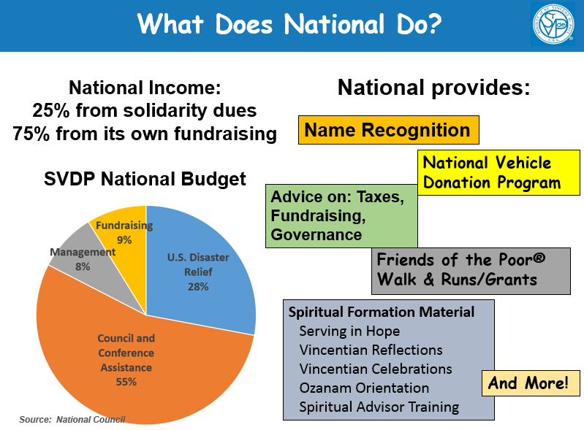
Moving Right Along…
Use this slide only in places where a new Council might make sense.
If officers have their own training, you may not need to cover all of these. Do name one or two which might be of local interest.
Explain what National does and how much of the budget supports Councils and Conferences.

Slide 120
More on Confidentiality
Review Formator’s Guide for detailed information on these and other frequently-raised issues:
If a person is in danger of injuring himself or others
Suspected abuse of a child or vulnerable adult (see appendix in Participant’s Guide)
Other agencies asking for “lists of our clients”
Safeguarding information sent via email or to a shared printer
In Formator’s Guide, “Conference Life” pg. 127
Notes:
Note to trainer if participants in Formator training are from different dioceses, discussing these issues in detail may bog down your training because each diocese handles the first three a little differently. See Formator’s Guide.
If your participants are all from one Diocesan Council, you may want to check whether the Council already has agreed-upon answers for the first three.

Slide 121
Part 6: Understanding Poverty
What: Formation. We aren’t presenting everything.
Who: Someone with a complete understanding of poverty; very aware of their own language and has had personal experience with people in poverty.
This information may be completely new to some.
In Formator’s Guide, see VIII.F. “Understanding Poverty” pg 44
Notes:
This is a hard section, and it is not realistic to think that all presenters will be able to do it justice. Not only is it long and complicated, it is unfortunately easy to unintentionally give the impression of condescension, racism, or arrogance.
Best presenter: more experience with people in poverty the better – e.g. someone who works with people in poverty as part of their job – and someone who is aware of their language. That often means someone who has worked or lived in a culture other than the one they grew up in.
Hints about language to use and *not* use and approaches to particularly challenging slides are in the speaker notes and Formator’s Guide.
For instance, “those people” doesn’t come across well. And it’s too easy to say this.
New “Cultural Change” is in this section. Do read the handout and comments in Formator’s Guide on this topic.
Despite the amount of work needed to prepare, this can be a very rewarding section. The Formator often gets to see a participant have an “Aha!” moment right during the class. We’ve seen people changing their minds, gaining new understanding and new empathy for some of the people we serve.
To person running the formator training:
We very strongly recommend that you expect any presenter wanting to give this section to first read the first half of “Bridges to Sustainable Communities”. This explains the concepts in more detail than the Orientation does.
Then, make sure trainee has read and understands the advice in speaker notes and Formator’s Guide concerning language. The advice isn’t covering everything but it helps.
A short discussion among all trainees about what this means, and asking them to give some examples of what to say and not say, might help.
In practice sessions, do point out when trainees go over the line. They usually don’t know they’re doing it. Many just need to be made aware of certain habits, and they’ll be fine.

Slide 122
Part 6: Understanding Poverty
The aims of the Understanding Poverty section:
  Give our Vincentians some language and concepts that will combat being judgmental.
  Get them interested enough to learn more about poverty.
More education on Poverty beyond this is definitely needed, but this OO is providing a key experience to get people fired up.
Notes:
This section has been completely rewritten
The aims or learning objectives were redefined:
Give Vincentians language and concepts that help with judgementalism. Better understand what life is like for people in poverty, especially long-term or generational poverty.
Get Vincentians interested enough to learn more about what it’s like to be poor, why people are poor, what’s stopping the climb out of poverty in your area.

Slide 123
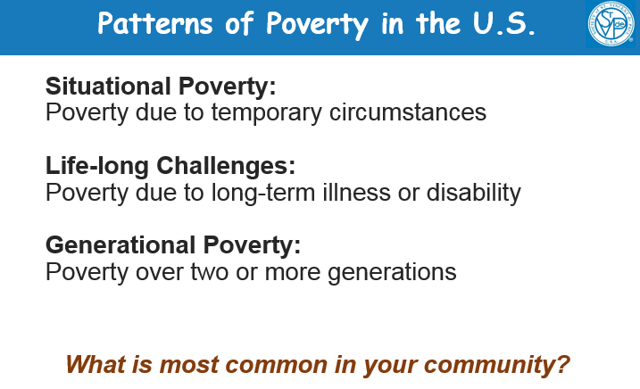
Patterns of Poverty
Emphasize that these are patterns, not absolute, and there are patterns which are not on this slide.
Every community has a different mix of patterns.
Ask about the community before the Orientation.
On this slide, ask the participants to share examples of patterns in their community.
Notes:
In each community, poverty has different "faces". There will be a different mix of situational poverty, life-long challenges, generational poverty, recent immigrants, and other patterns. Slide 101 provides an opportunity for the group to talk about their particular community. We recommend that you inquire about patterns of poverty in the community before the Orientation, so you are more familiar with the assumptions of your participants. In addition, Vincentians themselves are not always middle-class Americans of European extraction. When your audience is diverse, you may need to adjust the presentation. Remember that your goal is to give the participants some background so they better understand the challenges faced by people they serve.

Slide 124
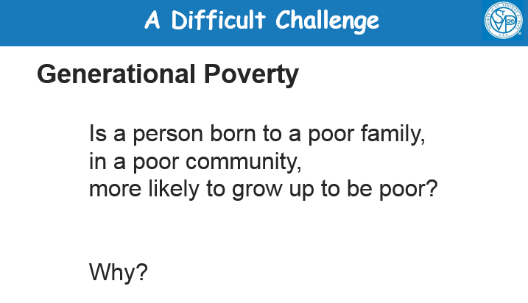
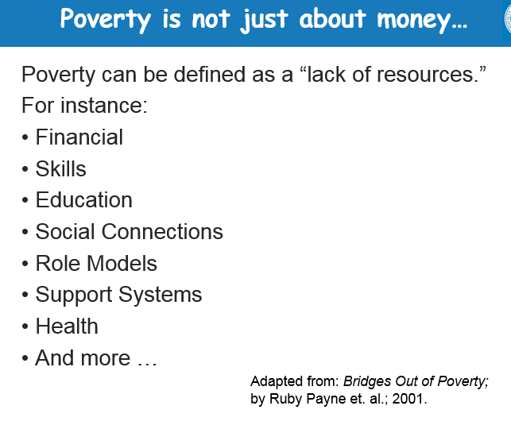
Tricky Slides
Be sure to make a distinction between “will grow up to be poor”
and
“more likely to grow up to be poor”
Some people may answer
“No – not more likely”.
Ask “why that answer?”
If it’s an example of having non-financial resources, use it to segue to “lack of resources”.
On this slide, “we didn’t know we were poor” example is powerful.

Slide 125
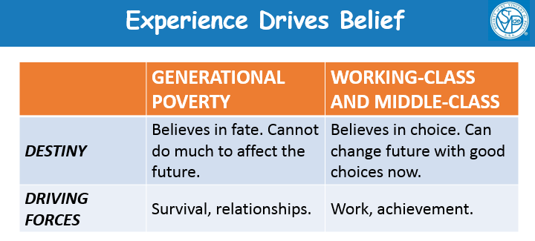
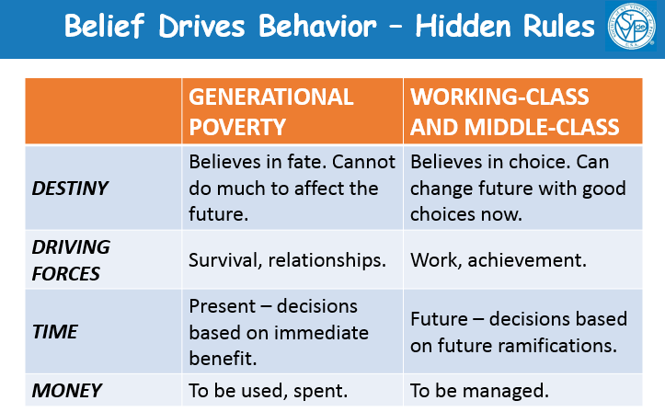

More Tricky Slides
The point of these slides
IS:
To explain that generational poverty behavior patterns are logical and reasonable, and are based on real experience in the community
IS NOT:
To compare generational poverty
and middle-class behavior
To assume that all people in generational poverty believe the same things.
Notes:
Make sure you understand and communicate the point of this sequence:
People in long-term poverty usually have many valid experiences where their efforts fail to change their future. Think sharecropping. This is more true when the community in poverty is bigger. They are real experiences, not mistaken beliefs. The “hidden rules” are different from what you’re used to.
This experience leads to believing that your actions have little effect on your future.
This belief leads to focusing on survival and on relationships with people in your community, who will help you.
And this leads to making decisions to benefit you and yours in the short term. And thus the big-screen TV in a household that’s having trouble paying rent.
These are real experiences. Read Bridges Out of Poverty for examples.
If your participants are not primarily middle-class, you may need to present this differently.

Slide 126
The Reasoning
When people find their effort doesn’t change their future, and this goes on for generations,
it’s natural to believe your actions can’t affect your future much.
Which leads to focusing on survival and on relationships with people in your community who help you.
Which leads to making decisions to benefit you and yours in the short term.
Notes:
Make sure you understand and communicate the point of this sequence:
People in long-term poverty usually have many valid experiences where their efforts fail to change their future. Think sharecropping. This is more true when the community in poverty is bigger. They are real experiences, not mistaken beliefs. The “hidden rules” are different from what you’re used to.
This experience leads to believing that your actions have little effect on your future.
This belief leads to focusing on survival and on relationships with people in your community, who will help you.
And this leads to making decisions to benefit you and yours in the short term. And thus the big-screen TV in a household that’s having trouble paying rent.
These are real experiences. Read Bridges Out of Poverty for examples.

Slide 127
Every Pattern Has Exceptions
Generational Poverty” doesn’t describe everyone in a poverty community. There’s always some who have faith in their ability to affect their future.
Recent immigrants typically don’t follow the generational poverty pattern.
Their experience is that action DOES affect the future.
After all, what did they just do?
Notes:
In each community, poverty has different "faces". There will be a different mix of situational poverty, life-long challenges, generational poverty, recent immigrants, and other patterns. Slide 101 provides an opportunity for the group to talk about their particular community. We recommend that you inquire about patterns of poverty in the community before the Orientation, so you are more familiar with the assumptions of your participants. In addition, Vincentians themselves are not always middle-class Americans of European extraction. When your audience is diverse, you may need to adjust the presentation. Remember that your goal is to give the participants some background so they better understand the challenges faced by people they serve.
Note for slide 107: Recent immigrants, despite a history of poverty, often fall into the “situational poverty” pattern rather than the “generational poverty” pattern. Immigrants tend to believe that they can change their future by their actions. Immigrating itself is taking a huge action to change your future. There can also be other cultural differences, depending on the country of origin.

Slide 128
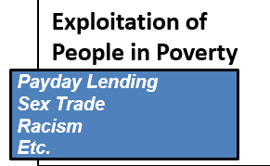
Language Tips
DO:
  Say “Racism” first or second, not last.
  Say “people living in poverty”.
  Keep repeating that these are
  patterns, not absolutes.
  Ask another Vincentian to listen for stumbles.
  Read the speaker notes and Formator Guide.
DON’T
  Say “Those people”.
  Assume all people in any group behave the same way.
Notes:
Pay close attention to your language. It is very easy to unintentionally come across as arrogant, prejudiced, or racist.

Slide 129
Wrapping Up
Watch the Time!!!! It is easy to run over by accident.
Always have small group discussion after this section. This helps people process what they’ve heard.
This section can be very rewarding
People gain new understanding and new empathy right before your eyes
Notes:
Despite the amount of work needed to prepare, this can be a very rewarding section. The Formator often gets to see a participant have an “Aha!” moment right during the class. We’ve seen people changing their minds, gaining new understanding and new empathy for some of the people we serve.

Slide 130
Part 7: Why We Do Home Visits
Learning Objectives: Formation
  Participant wants to try a home visit
  Not intending to teach all about home visits
Lecture and video because…
  Some people want to know the steps
  Some people want to know how it will feel
Shortened version of the LA video
  Questions and pauses are removed from video
  Just one video.
Interactive Q&A Exercise
  Based on LA Home Visit questions
  Makes people think
Notes:
This section is literally “why we do home visits and why you should too”
Objective is to persuade participant to try a home visit.
The presenters for this section must themselves have home visit experience.
Since this is just an introduction, not a full home visit training, you won’t be able to cover everything you know about home visits. Do share a story about why you do home visits, or how you got started doing home visits, or what they mean to you.
We still lecture about home visits, and show a video, and have a group discussion. This allows us to communicate with those who want to know what happens in a visit, and those who want to know what a visit would feel like. We’re addressing different learning styles.
For those of you familiar with the older versions of LA Home Visit video, this version uses just Start to Pause1.

Slide 131
Part 7: The Q&A
You have a checklist of Q&A on your flash drive.
Print it out for yourself, but don’t hand it out.
Suggested sequence:
  One person presents the slides before the video.
  Show the video.
  All presenters go to the front.
  Ask audience to share observations.
    What did our Vincentians do well? Do poorly?
  Keep track of what has been mentioned.
  Prompt for any questions missed.
  Back to slides for final wrap-up.
In Formator’s Guide, see VIII.G. “Home Visits” pg. 46
Notes:
The checklist has been updated from the 2012 version.
We have a suggested way to use the questions:
To person running formator training class:
You’ll want to hand out checklist to trainees.
Many of the trainees will not have done the home visit video this way, so you may want to practice “Ask audience to share observations”.
Here’s one way:
Split the class in half. Half will be participants, half will be formators.
Give each of the student formators a copy of the Home Visit Video Checklist.
Show the video (unless everyone already has it memorized).
Now the student formators stand up front and ask for observations.
As the “participants” give observations, the student formators check off the questions which have been covered.
After you think about 75% have been covered, stop the discussion.
Ask the student formators which ones have *not* been covered.
Then ask them to ask leading questions of the “participants” to get those remaining issues out on the table, such as “Do you think Mrs. Stanley is experiencing generational poverty or situational poverty? Why do you think so?”

Slide 132
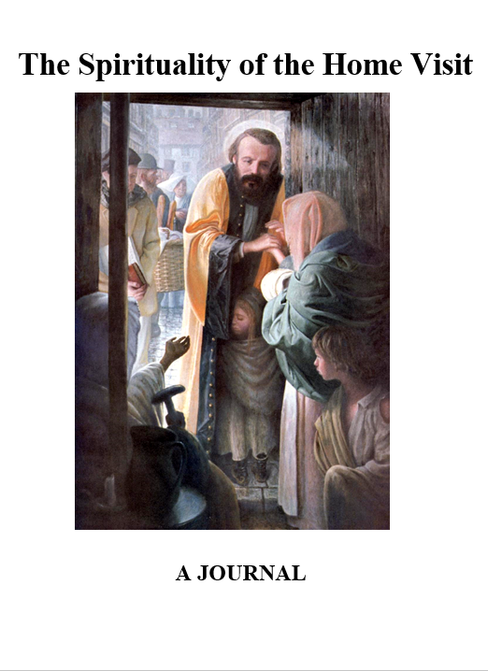
Home Visit Video Discussion
Checklist of questions.
  In “Formator Tools” on your flash drive.
  Updated to reflect our current understanding of causes of poverty and of physical contact during the home visit.
Notes on video
  Intentionally includes both good and bad practices
  Was made before sex abuse training was commonplace.
  Yes, there will eventually be a new video.
New Home Visit Journal
  Can be ordered from National
In Formator’s Guide, see VIII.G. “Home Visits” pg. 46
Notes:
Remind formators not to disparage the video – that doesn’t help the participants.
The next time there is a home visit video, it will incorporate systemic change
Home Visit Journal became available after OO was released.

Slide 133
Go Forth and Practice!
Attendees number off 1 to 7.
Each group will be assigned one part of the OO – parts 1 - 7.
Look over the presenter notes.
Note the time allocated (you will need to stay within this time frame but don’t finish too early)
Find a comfortable space to practice this session.
You will have 60 minutes.
Each person will present their part of the Ozanam.
Notes:
You can modify this depending on the number of participants. It is better to have three groups than seven individuals practicing, for example, so just assign a few of the sections to smaller groups. No one person is presenting all seven, so it’s okay not to include all of them here.

Slide 134
The Charity of Christ Urges Us
Dear Jesus Christ,
Send forth your Holy Spirit to fill our hearts with courage to create something new and the generosity of spirit to offer our time and energy to this ministry.
Create within this community the space for mutual support and understanding so that persons will find respite and restoration among friends.
Help us to set aside differences in our education, roles and responsibilities, and ministries to discover the love, compassion, and healing Grace of Jesus among us.

Slide 135
The Charity of Christ Urges Us
Dear Lord Jesus, We offer ourselves fully to the cultivation of a Vincentian Servant Leader heart. Open us to the willingness to receive your grace so that we wash the feet of our brothers and sisters as a sign of our service and solidarity
When we are gathered together, ignite our hearts with a passion for seeking you and inspire our minds with the creativity to find you in our relationships.
Lead us to your Sacred Heart, so that we may embrace the joy and pain of the Vincentian ministry, receiving your grace to strengthen our service to those who are poor, and vulnerable.
Oh healing Jesus, call us together so that we may offer ourselves to one another as companions along the journey to the well of your Love where we are nourished by your mercy.

Slide 136
Additional Topics

Slide 137
Recruiting: Invitation to Serve
Personal invitation works best
Focus on “Spirituality/Friendship/Service”
Recruiting program
  Week 1: Bulletin announcement with a “teaser”
  Week 3: Another bulletin announcement
  Week 5: Invitation to Serve pulpit talk with signups
  Week 6: 1-hour Intro to the Society & job listings
  Week 7-on: Conference Meetings
  Within three months: Ozanam Orientation
Invite people to participate in works right away
Suggested talks and announcements at:
https://members.ssvpusa.org/growth-revitalization/outreach/
Notes:
Formators often asked to give talk because they are good at talking
Don’t talk about how there is too much work.

Slide 138
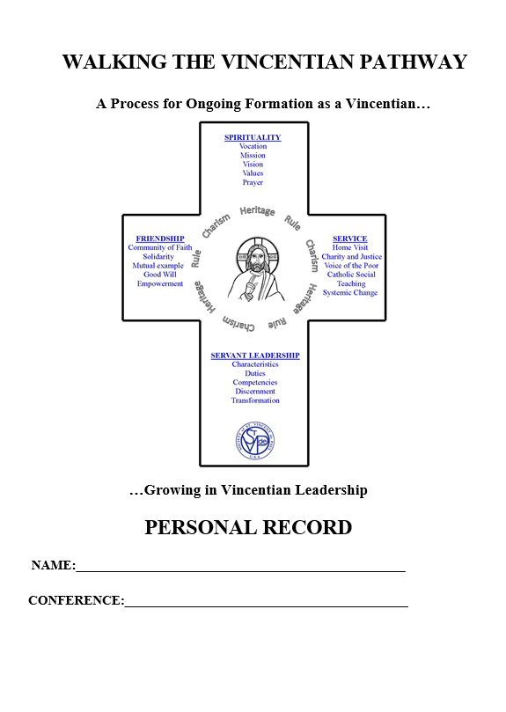
Ways to Expand Formation
More Home Visit Training
Lead “Serving in Hope” adoption in conferences
Book study
Spiritual Advisor training
Organize retreats
Explore the Vincentian
Pathway resources
Write training needed locally
(share with other councils)
<your idea here>

Slide 139
Starting a New Conference
Basic steps are:
Talk to the Pastor
Invite potential members to exploratory meeting
Exploratory meeting
First Conference meeting(s)
Startup Kit – all the logistics
Start serving those in need
Invitation to Serve – more members
Ozanam Orientation
Find out more at “Invitation to Serve”
https://members.ssvpusa.org/growth-revitalization/outreach/

Slide 140
English/Spanish Ozanam Orientation
Best to have a Spanish-only Orientation if you can.
If that’s not possible and you have a mixed group of English and Spanish speakers
Remember that most Spanish-speakers in the U.S. understand a great deal of English
  Discussion groups should be mixed as usual
Accommodate both languages
  Provide Participant’s Guide, Rule, Manual, and handouts in Spanish and English
  Avoid slang and colloquialisms
  Invite questions and listen carefully
Respect everyone
  Assume that all attendees will be full Conference members
  Lead at least one prayer in Spanish if you can
In Formator’s Guide, see VIII.H. “Mixed English/Spanish” pg. 47

Slide 141
Split-Day Ozanam Orientation
The Orientation is most effective when given in a single day. However…
Split-day is practical when:
  The two sessions are a week or less apart.
  Participants are required to attend both sessions.
Suggested split: two 3-hour sessions with homework as a “bridge”
  Sections 1-5 on Day 1
  Homework assignment: read Part 1 of the Rule.
  Sections 6 and 7 on Day 2
In Formator’s Guide, see VIII.I. “Split-Day” pg. 48

Slide 142
Questions or Comments
Thank you for joining us!

Slide 143
Closing Prayer
Vincentian Beatitudes
Together
- Happy are those who know how to laugh at themselves, they will never run out of amusement.
- Happy are those who know how to distinguish between a mountain and a molehill, they will be spared much trouble.
- Happy are those who know how to rest and to sleep without looking for excuses, they will become wise.
- Happy are those who can be silent and listen, they shall learn many new things.
- Happy are those who are intelligent enough not to take themselves too seriously, they shall be appreciated by those around them.

Slide 144
continued
- Happy are those who are attentive to others without thinking themselves indispensable, they will sow joy.
- Happy are those who know how to take little things and serious things peacefully, they will go far in life.
- Happy are those who can admire a smile and ignore a frown, they will travel in sunshine.
- Happy are those who can be silent and smile when interrupted, contradicted or stepped on, the Gospel is beginning to penetrate their heart.
- Happy especially are you who can recognize the Lord in all whom you meet, you have found true light and veritable wisdom.
Lord, grant us the wisdom to recognize you in all the events of each day and in all of those with whom we live and work, so the Beatitudes become rooted in our hearts. Amen

