Slide 1
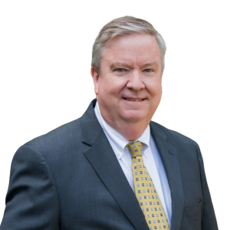
The Importance of Good Governance
John Hallissy
1st Vice President and Chair of the National Governance Committee

Slide 2

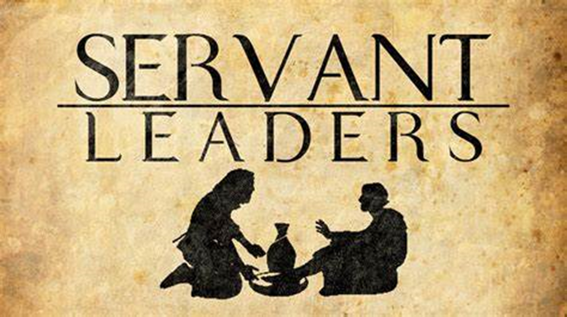
To be an Effective and Responsible
Servant Leader:
The Importance of Good Governance
Notes:
Offer greetings and perhaps introductions (depending on the size of the group).
2

Slide 3
To be an Effective and Responsible
Servant Leader: Good Governance
Our Five Virtues Prayer
St. Vincent de Paul,
Pray for us, that in our simplicity we may
always find honest words of love and comfort.
Pray for us, that our humility leads us to
seek God’s glory, not our own.
Pray for us, that with gentleness we offer
food to the hungry and shelter to the homeless.
Notes:
Begin with this prayer.
Our Five Virtues Prayer
St. Vincent de Paul,
Pray for us, that in our simplicity we may
always find honest words of love and comfort.
Pray for us, that our humility leads us to
seek God’s glory, not our own.
Pray for us, that with gentleness we offer
food to the hungry and shelter to the homeless.

Slide 4
To be an Effective and Responsible
Servant Leader: Good Governance
Our Five Virtues Prayer (continued)
Pray for us, that with selflessness we give
of our time, our possessions and ourselves.
Pray for us, that our zeal to share Christ’s
charity may light fires in the hearts of all we serve.
Amen
Notes:
Our Five Virtues Prayer (continued)
Pray for us, that with selflessness we give
of our time, our possessions and ourselves.
Pray for us, that our zeal to share Christ’s
charity may light fires in the hearts of all we serve.
Amen

Slide 5
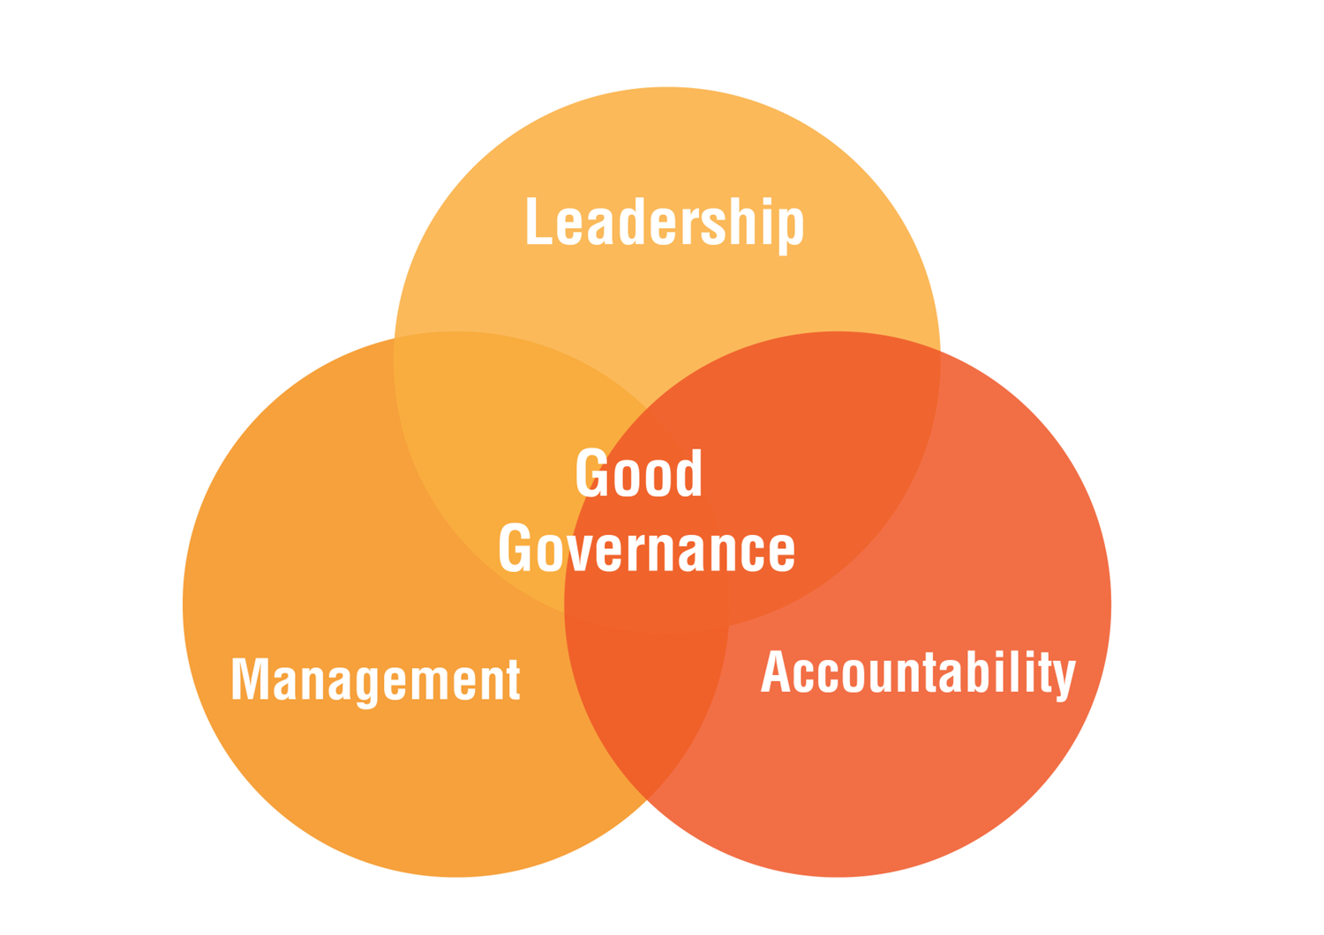
Why is Good Governance Important?
Notes:
This presentation was originally developed by John Hallissy, the leader of Governance and the National First VP under John Berry, National President.
.
When you look at that title, why good governance is important, you may be looking at it and thinking, “this may be boring,” or perhaps you are looking at it with fear and trepidation.
But our hope is when this workshop is done, you will feel more empowered when it comes to governance and perhaps you will go out and purchase a t-shirt with a big G on it because you may feel like a governance guru!
So let’s begin!
(At this point the Presenter should list their governance experience to give the attendees some reason to trust that you know about what you’re teaching.)

Slide 6

What are the twelve scariest words in the
Society of St. Vincent de Paul?
Notes:
What are the 12 scariest words in the Society St. Vincent DePaul?

Slide 7

I am from the Governance Committee, and
I am here to help!
Notes:
I'm from the governance committee and I'm here to help.
The Governance Committee is available to help Conferences or Councils that find themselves struggling with a governance issue. Of course, your first stop should be your Council President; your Second stop should be your regional VP, and then give a call to the Governance Committee, if you haven’t been able to resolve a situation.
The Governance Committee is here to help. The Governance committee is a group of people who are a resource for you as Vincentian leaders. That's what they are, they are not federal agents. They are Vincentians like you and me.
They were formed to be a resource so that when you have questions, you're not reinventing the wheel. The society has been around for over 200 years, and I seriously doubt that there'll be any question that comes up that has not been dealt with before in some way.
So instead of sitting out there with a question or a problem, just make a call and ask for help, starting first with your Council President.
So, let’s see what documents we have and what tools we have so we can work together to solve problems. Because that's ultimately what we should be doing.

Slide 8

What is Governance?
Notes:
Now, what exactly is governance?

Slide 9
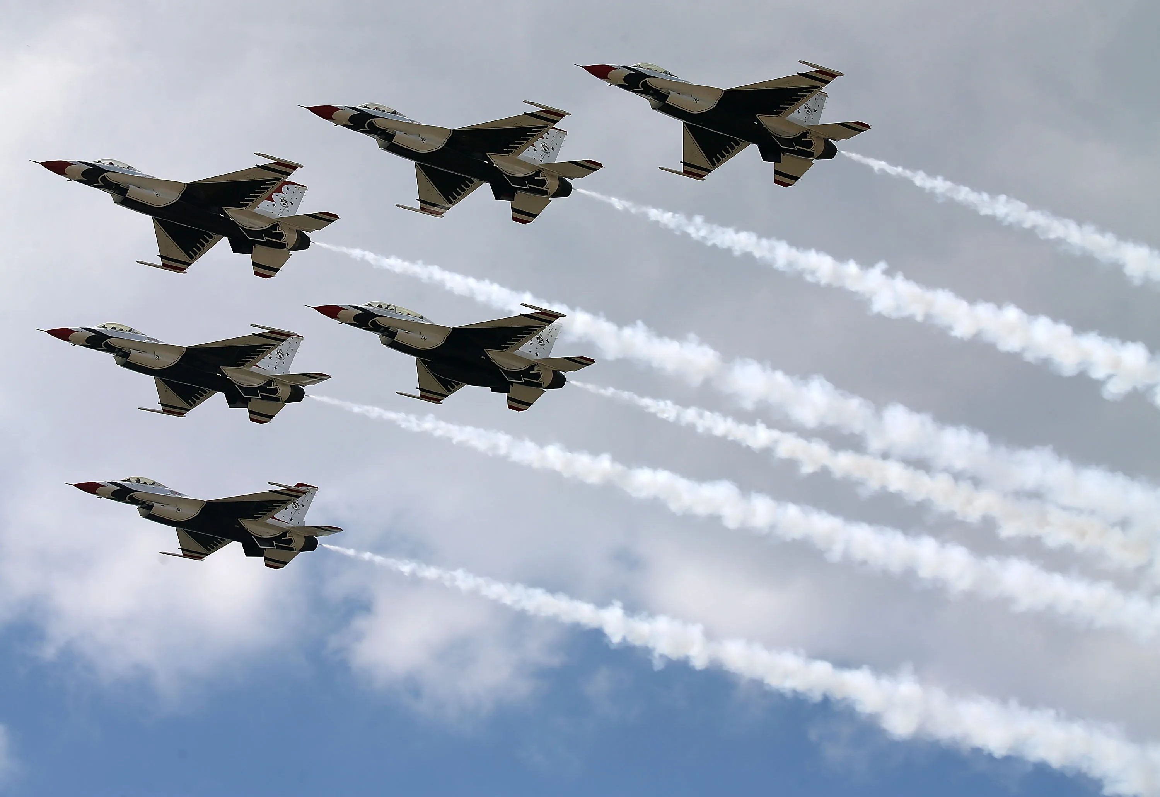

Governance refers to the structures that oversee the Society’s activities to ensure it fulfills its mission effectively and responsibly.
Notes:
The definition of governance: the structures that oversee the society's activities to ensure it fulfills its mission effectively and responsibly. It's basically the skeleton that runs the society.
If we are a member of the Air Force.we have a mission. Like the Aire Force, the members of the Society of St. Vincent de Paul also have a mission. Our mission is to grow in our spirituality and friendship through service to the poor. Ultimately, that’s our primary Vincentian mission.
If we are in the Air force, how do we accomplish our mission? Well, we need a airplane. In the case of the Society, the airplane is composed of the conferences and councils. That's how we accomplish our mission. We have friends in our conferences, we have friends in our councils, and we serve those in need through our conferences. That's what we do.
But to fulfill its mission the airplane the Air Force uses needs fuel, doesn’t it?
Otherwise, the plane just sits on the tarmac. It can’t do anything. For the Society in this analogy the fuel is our spirituality. The spirituality of the Society gives it the fuel to complete its mission through its councils and conferences.
Now you may ask, how does governance fit in to this analogy? The way to think about it is: governance is like the cables inside a plane that make the things move. The plane can't move without cables. A Boeing 737 has 40 miles of cables inside that plane to move the elevator and the ailerons and do whatever else needs to work to fly the plane. Just as the plane needs a lot of cable, the Society needs a lot of governance practices. They represent those cables.

Slide 10
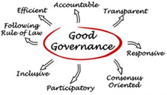
Why do we need
good governance?
Notes:
So that's what governance is. It's the structure that holds it all together. Now, why do we need good governance?
Why can't we just do what we want?

Slide 11
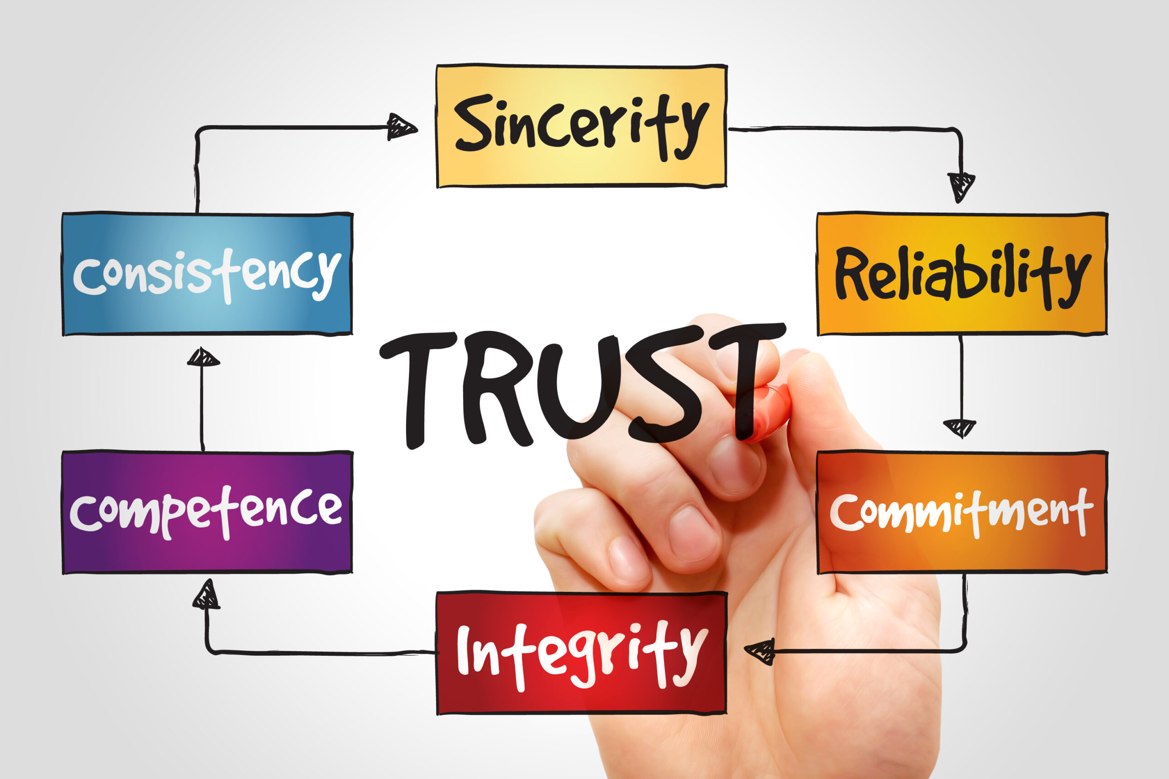
Builds Trust and Credibility
Good governance practices help the Society build trust with donors, funders, and the communities they serve.
This trust is essential for:
Attracting and retaining talented staff and volunteers
Securing funding and donations
Maintaining a positive reputation
Recruitment
Notes:
The reason is good governance builds trust and credibility. First, it helps the society build trust. Trust with its donors, its funders, its volunteers, its staff, and the communities being served. That trust is essential to attract and retain talented staff and volunteers. If you have a council that has employees, you especially need good governance. Good governance practices allow members and volunteers to know what is expected within the organization. If you want to attract members and volunteers, you're going to need good governance to retain them. No one wants to be a part of an organization that is in a mess.
Second, good governance helps to secure funding, to bring in donations, and to encourage growth. If you do not have good governance, people are not going to donate to you. If you have some financial scandal that is discovered by the community, such as embezzlement, it’s never ends well. People will think “If you were practicing good governance, this wouldn't have happened.” Then people don’t donate to you. Keeping a positive reputation is essential.
We must also avoid a negative reputation with the pastor or the bishop, because we need them to grow new conferences in areas where we have no current presence. And if our reputation down at the chancery office in the diocese is that St. Vincent de Paul has nice nice people, but they just don't have their act together, we are not going to grow effectively.
And third, good governance helps in recruitment. If you're trying to recruit new members at your parish by personally inviting them, but the word is out that the people of this St. Vincent de Paul conference don’t know what they are doing … then we’ve lost an opportunity.
So if you want to have recruitment be effective, have good governance; people are attracted to things that work. Success breeds success. If something is well run, people are going to want to join and be a part of that organization. Rumor after rumor about this problem and that problem is never helpful to your recruitment efforts.

Slide 12

Good governance makes the Society’s functioning transparent and allows us to hold each other accountable:
Hold the organization accountable to its stakeholders:
Pastors
Donors
Our Families
Notes:
Good governance makes the society transparent and allows us to hold each other accountable. It's not just a set of rules.
We have responsibilities. All of us have responsibilities in our roles within the Society. The National President, John Berry, has responsibilities, so too do the National Council Members, the RVPs, and all Council and Conference Presidents. We all have responsibilities and we have to hold each other accountable. We also have to hold each other accountable to what are call our stakeholders.
Who would be on a list of our stakeholders in this society?
We, as members of the Society, are not the only stakeholders. A stakeholder is someone who is affected by the society, who has some sort of share in what we do or how we do it.
Pastors in the parishes where we are located, or more importantly where we want to be located, are stakeholders. They do not want to have an organization that is not well-run.
Donors are stakeholders. If you're going to ask people for money, they become a stakeholder. And they want to have good governance.
Some would say that our families are also stakeholders. It's important that we all think about that for a moment. Running a conference or a council, or being an officer of a council or a conference, can be a stressful position. Vincentians who call for help from the Governance committee are often very stressed out because they've just learned that there's some problem and they're appropriately concerned. Yet you have your family, your children, and grandkids, as well as other family members that you need to care for. However, if we have well-run conferences and councils, and good governance, it will take that stress level down, at least a couple of notches so we can be better members of our family, which is ultimately what we want to be. So, the family is a stakeholder.

Slide 13
Good governance makes the Society’s functioning transparent and allows us to hold each other accountable:
Hold the organization accountable to its stakeholders:
Those we serve
Potential Vincentians
Minimize risks of financial mismanagement and legal troubles
Helps us become more effective in our mission
Notes:
Those we serve are very important stakeholders. If our councils and conferences are not well- run, we are not doing the most effective job we can do to achieve our mission. If we have good governance, well-run operations, we'll be more efficient and more effective, able to serve those in need much better, and/or we will be able to serve more neighbors in need.
Our stakeholder list should also include people who are not currently members of the society, because they are potential members.
We all have a Vincentian vocation. And we're glad we have our Vincentian vocation. There are other people who may want to join us in that Vincentian vocation, but if our councils or conferences do not practice good governance, people who might decide not to join and miss out on this vocation as Vincentians. In that way, they can be considered stakeholders.
This list of stakeholders is not exhaustive. Perhaps you can think of others who are stakeholders, too. However, the key point is that we are responsible to others and, therefore, need to be accountable for what we do.
It is especially important to note that Good Governance also minimizes the risk of financial mismanagement and legal troubles. If we have good practices in place, it is less likely that we'll run into financial troubles or run into legal troubles.
And lastly, good governance helps us become more effective in our mission.

Slide 14

Who is responsible for good governance?
Notes:
Who is responsible for good governance?

Slide 15
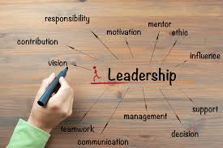

Good governance is the responsibility of the leadership of Conferences and Councils.
Notes:
The answer is simple: Good governance is the responsibility of the leadership of Councils and Conferences.

Slide 16

Good governance needs to be written down
The fundamental governance document is your Bylaws
Also: Tax Exempt status requirements
990
Annual Reports
Proper election procedures
Communication
Training for Officers and Board/Council Members
Notes:
Good governance needs to be written down. It's not a verbal agreement. We’re a society, we write things down. So what then are the fundamental documents of good governance?
The first is your Bylaws. Every level of the Society needs bylaws. And we'll talk about that in a little while.
But there's other parts as well.
One such part involves the requirements for tax exempt status – such as our 990 forms with the IRS. That's part of good governance. Making sure the 990s are filed properly and we submit timely, annual reports, that’s all part of it.
Another is proper election procedures that are written down and in accordance with the bylaws. If an election is run according to your election procedures, you will not have to call the Governance committee to say: “We had an election and now there's a dispute.” Within the Society we assume everyone has a good heart, but if there are no documents to govern the Society, it can cause confusion.
When good governance is in place it’s simple: here are our bylaws, here are the rules for the election. That can solve a lot of problems.
It is really important that when you have governance documents, the officers of a conference or council, and the board members and council members know about them and have been trained about governance and these procedures. If you are going to take away one thing from this workshop, this is it.

Slide 17
Good Governance and Bylaws
Bylaws are internal governing rules for an organization, such as a corporation or non-profit, that define its structure, operations, and decision-making processes, covering aspects like meetings, officer duties, voting, and amendments.
Notes:
Just a quick clarification about Bylaws.
Bylaws are internal governing rules for an organization, such as a corporation or non-profit, that define its structure, operations, and decision-making processes, covering aspects like meetings, officer duties, voting, and amendments. They establish a legal framework for how the organization functions. They are often vital for ensuring transparency, managing conflict, and providing clarity for internal affairs.
The National Council can provide sample Bylaws to all councils and conferences should they need them.
Continuing the earlier analogy of the airplane, good governance, and particularly bylaws, are what we consider the checklist. Let’s look at that analogy for a moment.
When pilots fly in a plane and the engines flame out or something else mechanical goes wrong, you don't want to have the pilot say to the copilot: “What do we do now?” That is not going to work out well. But the plane usually has a checklist. The pilot asks the copilot when an emergency occurs to immediately review that list. So the copilot grabs the checklist and starts going down the checklist that was drawn up before there's a crisis. Consequently, there is a much higher likelihood of success and avoiding a crash landing. Good governance, and specifically bylaws, are like that checklist. Good governance practices can, and frequently do, help to save an organization from a disaster.

Slide 18
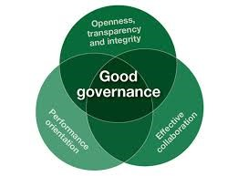

Governance documents are useless
if they simply sit on a shelf.
Notes:
Governance documents are useless if they just sit on a shelf. We can all pat ourselves on the back and celebrate our updated bylaws. But then they stay sitting in the computer.
Does anyone read them? No, but we have great Bylaws. Do we follow them? No, but we have great Bylaws.
You have to have Bylaws which are updated and proper, and then you have to act on them.
You have to use them and follow them. You'd be surprised how many people have bylaws and then just forget about them. Officers change in Conferences and Councils, so they must know where to find the governance documents and how to apply them.
Everyone in your Council or Conference may know the history of what happened at your Council or Conference last week, or even last year because you were there. Ten years from now, there will be different people in leadership. They're going to be the ones making the decisions. And they can't rely simply on oral history or memory.
We need to write it down and make it accessible. Guidelines and procedures can't be buried in the minutes of a meeting from 2012, because no one's going to find them.

Slide 19

Ask yourself:
*When was the last time your Conference or Council collectively read and/or reviewed your bylaws?
*When was the last time your Council collectively reviewed your Conferences’ annual reports or, at least, summaries?
*When was the last time someone in your Council was tasked with reviewing, in detail, the Bylaws and other governance documents of your Conferences?
Notes:
Here are some questions just to reflect on:
When was the last time your Council or Conference collectively reviewed your Bylaws?
One suggestion is, take your Bylaws, break them up into thirds because you can only absorb so much at a time, and read as a group. If you do this over 3 or 4 meetings, then everyone is truly aware of the Bylaws. This gives people an opportunity to ask questions. You can have a little discussion. You’re probably not going to change the Bylaws, but you can discuss it so that everyone is aware of what is in the bylaws, and know what the rules are.
When's the last time your Council or Conference read your Bylaws ?
When is the last time your council collectively reviewed your constituent conferences’ annual reports? or at least a summary such as the consolidated report? Not just the treasurer, but that your whole Council sat down and at least had a summary of the activities of the Conferences in your Council?
When is the last time someone in your Council was tasked with reviewing in detail, the bylaws and other governance documents of the Conferences? We can't just assume that, if there's 10 Conferences in a District Council, that the Conferences have everything squared away. They may, and hopefully they do, but we need to be certain that they are fine.

Slide 20

Ask yourself:
*If you have special works, are their Bylaws current and in compliance with the National Council’s recommendations?
*Are your Conferences aggregated or on the path to aggregation? Do you have a process to encourage and monitor aggregation?
*Is your Council instituted? If not, do you have a process that you are working towards institution?
Notes:
If you have special works, you need to check If they have their bylaws, current and in compliance with the national recommendations.
Are your conferences aggregated or on the path of aggregation?
Aggregation is the formal process where a conference becomes fully integrated into the society through an application to the international office in Paris. As National Council Members, we want to have a list of which Conferences are aggregated and when, so you can follow up on any that have not yet been aggregated.
Are they on the path to aggregation? Do you have a process in place to follow up?
Now, is your council instituted? Institution is basically like aggregation, but for councils, the term is instituted.
Is your council instituted and your district councils instituted? And if not, again, what is the process for you to do that?

Slide 21

Ask yourself:
Is someone within your council tasked with making sure your conferences are up-to-date with their tax-exempt status requirements?
FEINS
990’s
Requirements with Secretaries of State
Notes:
Is someone within your Council tasked with making sure that your Conferences are up to date with their tax-exempt status requirements?
Some Conferences are covered under the Council’s tax-exemption, some have their own tax-exempt letter from the IRS somewhere under the umbrella of the Council, and some have their own tax exemption. Whatever the situation is, be sure the Conference is staying IRS compliant. You don't want to run into problems with donations being made to a Conference that is not tax exempt because that presents a problem for the donor who cannot take the donation as a deduction. Again, it’s a matter of good governance.
The things to look for: using the correct FEINs (Federal Employer Identification Numbers), 990s are being filed on time and copies are kept, and compliance with secretaries of state.
Each state is different, but in many states, Councils must register as a charity with the secretary of state. There are also some state and local laws about running raffles. Please be make sure Conferences and Councils are compliant with state requirements, including any permits or licenses for running raffles.
This is something to be discussed at your Council meetings so everyone is aware of what needs to be done and the consequences if not compliant.

Slide 22
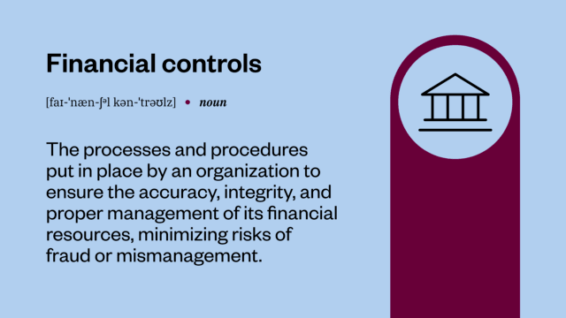

Ask yourself:
*Are good financial controls in place and utilized
both at the Council and Conference levels?
*Is someone at the Council level tasked with making sure Conferences have a spiritual advisor, and if not, helping them recruit and train a spiritual advisor?
Notes:
it's part of good governance to make sure that there are good financial controls in place and utilized both at the conference and council level. Take a look at the newly updated Treasurer’s manual for that. Regular financial reviews or audits are important.
Is someone at the council level tasked with making sure conferences have a spiritual advisor? That's part of governance too.
We talked about spirituality being the fuel of the plane on our mission. Is someone in charge of that? Because just saying, well, yeah, the bylaws say we should have a spiritual advisor at the council. Yeah, that's true. But whose job is it?
And is it being done to make sure we have a spiritual advisor and maybe a backup if he or she cannot be there for a meeting?
Are we making sure that the spiritual advisors at the conference level are present at the meetings and are “formed.” That they truly exist and they're properly trained.
The most important thing is that you ask for help. Let us know that there is a problem.

Slide 23

Who is responsible for good governance?
Ultimately we all are!
If you see something, say something.
But do Vincentians know who to contact if they perceive issues with governance?
Notes:
So let’s go back to the question earlier, who's responsible for good governance? The leadership is, but ultimately we all are: we're all responsible for good governance. Now this part's important.
If you see something that's going on and it doesn't feel right, say something. It’s important to ask questions. If you have concerns about the finances, ask the questions. It’s better to know and catch a problem early.
We're all responsible for governance. So if there are questions that come up, ask to read the bylaws. And if we review them periodically, perhaps every few years and everyone has access to the council or the conference bylaws, then they can answer their own questions.
And if things are not being done according to the way they should be done, ask questions.
Here's another kind of reflective question for you. Do Vincentians at the conference or the council level know who to contact if they perceive a governance problem? Is there, a person at the council level who conference members can contact if they think there's something wrong?
Every member should know there's someone at the council he/she can contact to answer a question.
Sometimes someone just needs to be reassured and have a more thorough explanation of what the bylaws mean. That will ease the conference members' anxiety. But if a member sees something and nobody answers his/her questions, then we create a potential problem. There may actually be nothing wrong. However, the member does not know that and may go to others and the situation escalates unnecessarily.
Good communication is essential.

Slide 24

If you feel you have issues with governance, please do not ignore it or kick the can down the road – it will only get worse.
Please face your governance issues head on:
Reach out early to your Council President or Regional Vice President – he or she is there to help.
Notes:
If you feel you have a governance problem, don't ignore it.
There's a natural tendency to avoid picking up a rock in the road, because you’re afraid what might be under that rock. It's a human reaction. You know, there’s probably something nasty under the rock.
So as a Council or Conference President, you think: “ I have one year left of my term. I think I'll just leave it be and let my successor take care of it.” Don't do it because what is under that rock may cause more damage than you can imagine. It will only get worse.
It's uncomfortable to deal with governance problems; it's no fun. But ultimately, we all have responsibility.
When you're a conference president, council president, treasurer, whatever your leadership role is, there is a responsibility to act when you notice something is wrong. It may be a difficult issue. You may not want to deal with it. But you have to deal with it. Please deal with it.
So what do you do? You face the issue head on. If there's a governance problem, the first stop is the council president, if you’re a Conference Officer. For councils, your first stop should be with your regional vice president. The next stop is the national governance committee.
For most Council Presidents, the regional vice presidents are your first stop for governance issues for two reasons. The first reason is that regional VPs need to be aware of the problems in their regions. They need to know what's going on to help resolve the problem and work with the NCM to resolve the problem. RVPs will have the resources to help resolve most problems. They're the best resource.

Slide 25
Role of the Standards of Excellence
(SOE)
Resolution 119 (2015)
Notes:
Now we are going to talk about the Role of the Standards of Excellence.
The Standards of Excellence provide a framework to ensure that councils, conferences and the national council can practice good governance.
Basically, the Standards of Excellence has a list of what cables you need in your airplane and which ones are the most critical.
The Standards of Excellence started in 2015 with National Resolution 119.
(passing resolutions is part of National’s governance structure).

Slide 26

Role of the Standards of Excellence
(SOE)
Resolution 119 (2015)
The Standards of Excellence provide
CRITERIA – what do you really need to do
URGENCY – which of these should be addressed first and why
The criteria came from:
our Rule
requirements of federal, state, and local governments
requirements of the U.S. Catholic Conference of Bishops
well accepted practices in nonprofit governance
Notes:
The Standards of Excellence provide a framework to ensure that councils, conferences and the national council can practice good governance.
The Standards of Excellence or SOE provide
CRITERIA – what do you need to do
URGENCY – which of these should be addressed first and why
Resolution 119, passed in 2015, established the criteria. The criteria are based on
our Rule
requirements of federal, state, and local governments
Requirements of the U.S. Catholic Conference of Bishops
Well accepted practices in nonprofit governance

Slide 27

Standards of Excellence is a tool to achieve good governance
The Standards of Excellence should be a regular annual practice, just like the Annual Report.
They are broken down into three sections:
You can think of them as
red light, yellow light, green light
Situations
Notes:
The standards of excellence, are the tool to achieve what we have been discussing.
The standards of excellence are the pathway to make sure we have good governance.
The use of the standards of excellence by conferences and councils should become a regular annual practice. Just like the annual reports.
Do your annual reports and then do your standard of excellence questionnaires and then pass them up to the next level.
If this becomes a regular practice, just like the annual reports, then everyone will know that when the Vincentian fiscal year ends at the end of September not only annual reports need to be completed in October and November, but also the SOE.
That's the rhythm of the society. To help resolve a lot of these governance problems, assessing ourselves against the standards of excellence should become part of that rhythm.
The standards of excellence questionnaires are broken down into three sections.
Required Practices
Standard Operating Procedures and Practices
Recommended Best Practices
You can think of them as a red light section, a yellow light section, and a green light section.

Slide 28

Required Practices
Red Light
All Home Visits and other interviews are made by two Vincentians
The Conference maintains a bank account separate from the parish, under the control of the Conference Treasurer
The Conference has 501(c)(3) tax exemption, either on its own or through its Council; filing a 990 annually or providing the input required for the Council’s 990
Notes:
Let me give you examples of what we are calling the red light section. And this applies to councils or conferences.
Do we have a 501(c)3 exemption? Have we been filing our 990? Are annual reports being done every year and submitted? These are a few examples – there are more in the questionnaires.
When these things are NOT happening, that's a red light situation. And by “red light” we mean that when you realize you have this situation, you stop whatever you're doing, and you deal with this.
This is not the kind of thing you can deal with next year. No, in that first section, if you're not able to answer yes for each item, then that is a red light situation. You need to stop. Talk to your next level of leadership.
And that’s okay. There's no shame. It's not like anyone's going to be angry. The Society is grateful that you have recognized governance problems. It's when the IRS sends a letter and says that you haven't filed tax returns for four years – THAT shows someone is asleep at the switch.
It’s much easier to fix these problems BEFORE the IRS sends a letter.

Slide 29

Red Light
The Conference President has served no more than two consecutive 3-year terms
No donations are used to fund other charities no matter how worthy
Notes:
More examples from John

Slide 30

SOE consists of 3 documents
Report Sheet:
What you learned and what you will do.
Questionnaire:
the review questions
Notes:
explanations and examples
NOTE: at the Conference level there is a set of minimum requirements together.
Notes:
At this point, some of you will be asking “so why is that a Red Light situation”
The SOE consists of three files or documents for each level: Questionnaire, Notes, and Report Sheet.
There are separate file sets for Conferences, Councils which are not separately incorporated, and Councils which are separately incorporated.
Conference level also has “Minimum Requirements”.

Slide 31

Standard Operating Procedures
Yellow Light
The Conference meets regularly and frequently, and not less often than twice a month.
The Conference attends District meetings and takes part in programs and events sponsored by their District/Diocesan Councils.
What percent of Conference members have attended Ozanam Orientation? What is the plan for those who have not?
Notes:
Now the yellow light section involves things that should be done.
They're not red light, but they should be done.
For example, having Ozanam Orientations.
Updating the national member database. Things like that. Really important.
For example, a Conference reports that very few members have attended Ozanam Orientation. The Council reviews the Standards of Excellence and asks how they can support the Conference in clearing this issue up.
However, if the Council doesn’t provide Ozanam Orientations, perhaps the Council had better start. That might be a red light for the Council!

Slide 32
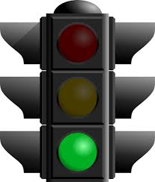
Green Light
Does the Council have a Governance training program? (for Councils)
Does the Conference have a file/list of local resources for the members to share with friends in need?
Do you have a Voice for the Poor representative?
How many members have attended a National/Regional meeting?
Notes:
And then what I'm calling a green light, the last section are kind of for the star pupils in the class. You know, if you get the extra credit for participating in voice for the poor? Do you have an advocate or someone, a rep for voice for the poor?
You should. And that's really good that you do.
In the Council SOE - do you have a governance training program? Do you have someone within your council who can kind of do what I'm doing today for your councils and conferences and explaining the importance of good governance?
So those are all kind of star pupil things we should be doing.

Slide 33


The SOE is not a report card where there are penalties
They are a prioritization tool
to identify items that need to get done this year and items that should get done in the next year.
Notes:
It's important that you don't think of the standards of excellence as a report card.
It's not high school where anyone's grading it. And we’re not gonna put a letter grade on your form.
.
It's a self-reflection. It's allowing you to sit down as a group, either your council of conferences, take a look at where you are in governance, and then it's a really a tool to prioritize what needs to be done.
And again, we want to have this become a regular part of the society, the standards of excellence, so that it can be in the lifeblood of the society.

Slide 34
SOE Process
Questionnaire:
the review questions
Notes:
explanations and examples
Report Sheet:
What you learned and what you will do.
Start by reading the Questionnaire together.
If the answer isn’t obviously yes, consult the Notes file.
Decide what you’re going to do this year and add to your own annual plan.
Provide results and plan to your parent Council in the Report Sheet.
Notes:
The SOE consists of three files for each level: Questionnaire, Notes, and Report Sheet.
There are separate file sets for Conferences, Councils which are not separately incorporated, and Councils which are separately incorporated.
Conference level also has “Minimum Requirements”.
Start by reading the Questionnaire together.
If the answer isn’t obviously yes, consult the Notes file.
Contains commentary for each question, explaining why this is required and where to get more information and/or help.
Decide what you’re going to do this year and add to your own plan.
Provide assessment results and plan to your parent Council in the Report Sheet.

Slide 35
Terminology: What is a SALE?
SALE = Stand-alone legal entity.
For example, all District Councils in the Archdiocese of Seattle are SALEs.
Four of the District Councils have combined their Conferences and the Council
into a single corporation.
  All Conferences use Council’s EIN.
  Council files one 990 for the whole group.
  Council directs administration/bookkeeping.
Corporation
District
Council
Conference
Conference
Conference
Conference
Notes:
SALE = Stand-alone legal entity.
For example, all District Councils in the Archdiocese of Seattle are SALEs.
They each have their own EIN and their own tax exemption.
Four of the District Councils have all their Conferences under the District Council tax exemption. The Conferences are not SALEs.
However, two of the District Councils have separately incorporated Conferences which have their own incorporation, their own EIN, their own tax exemption. Those Conferences are SALEs.
If this is super confusing < next slide >

Slide 36


See Survival Kit Webinar for:
A tutorial on incorporation status and what it means.
(useful if some Conferences are separately incorporated).
A template to keep track of your key governance information.
A practical tutorial on how to lay out your plan for the year
without getting overwhelmed.
Template for an annual plan: track what needs to be done and when.
https://members.ssvpusa.org/leadership-training/ under “Conference Presidents”
Notes:
Something that might be helpful is to watch the Survival Kit webinar.
This explains the SALE issue so you know who has to file what.
There are more than three ways to incorporate.
A considerable number of governance issues depend on how you are incorporated.
The Survival Kit Webinar for Conference Presidents also has a good tutorial on planning and a planning tool for you to use.
Many Conferences identify what they need to do but then can’t figure out how to get it done. Things just fall off their plates. If that happens to you, the webinar might help.
https://members.ssvpusa.org/leadership-training/

Slide 37
To Contact the
National Governance Committee:
Pam Hudson Johnson
314-576-3993 Ext. 214 | phudson@svdpusa.org

Slide 38
To be an Effective and Responsible
Servant Leader:
The Importance of Good Governance
Thank You for attending!
Notes:
Thank you for attending this webinar. Instructions about asking questions.
38

Slide 39

Questions?
You can also email
Tim Williams
Sr. Director, Formation & Leadership Development
twilliams@svdpusa.org

