Slide 1
Children’s Tax Credit: Politics and Advocacy
Voice of the Poor: Third Thursday Webinar
December 2022

Slide 2
Agenda
Opening Prayer
The Background
The Other Side
The Politics
The Advocacy Plan
Closing Prayer

Slide 3
Opening prayer
Lord Jesus,
Master of both the light and the darkness, send your Holy Spirit upon our preparations for Christmas.
We who have so much to do and seek quiet spaces to hear your voice each day,
We who are anxious over many things look forward to your coming among us.
We who are blessed in so many ways long for the complete joy of your kingdom.
We whose hearts are heavy seek the joy of your presence.
We are your people, walking in darkness, yet seeking the light.
To you we say, "Come Lord Jesus!'
Amen.
- Henri J.M. Nouwen

Slide 4
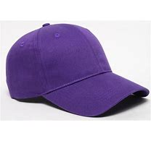
Before we get started
If you are wearing one of these, please remove it for the next 45 minutes.
And put on this hat
If you thought I was going to ask you to put on this hat, well…

Slide 5
Child Tax Credit Background
Available to families to help pay for the costs of raising children. In 2017, the max value of the credit was raised to $2k per child but limited the amount families could receive as a refund to $1,400 per child ($1,500 in 2022 due to indexing for inflation).
Low-income families who owed little or no federal income taxes were unable to receive the full benefit of the credit.
To cushion the impact of the pandemic, the 2021 American Rescue Plan Act (ARPA) made temporary changes that enhanced and expanded the credit, including making it fully available to low-income families.

Slide 6
American Rescue Plan & The CTC in 2021
Increased from $2K per child to $3K per child (age 6-17)
$3,600 per child under the age of 6
Made fully refundable to ensure that lowest-income families could receive the full value of the credit
Credit split into monthly payments and credit on family's tax return

Slide 7
REFUNDABILITY & Monthly Payments
Refundability - Making the full value of the credit available to families with low / no incomes on the year
Another important feature of the program was its monthly payment schedule, providing smaller, predictable cash infusions to families. This reduces hardship and buffers against income and expense volatility that occurs throughout the year.

Slide 8
CTC Results in 2021
Child poverty fell to 5.2%, the lowest rate on record according to Census Bureau.
Largest single-year decline in child poverty on record.
The CTC lifted 5.3 million people—including 2.9 million children—out of poverty in 2021.
Results driven primarily by the expanded (CTC) in the American Rescue Plan (ARPA).

Slide 9
CTC Impact: In their own words
Amber Quote 1 #CTCNow 12-07 Press Conference.mov - Google Drive
Cory Booker Quote #CTCNow 12-07 Press Conference.mov - Google Drive
Ritchie Torres Quote #CTCNow 12-07 Press Conference.mov - Google Drive

Slide 10
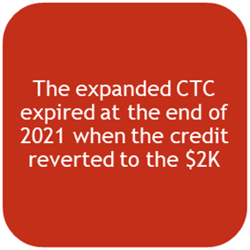
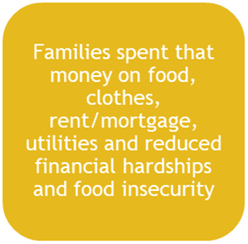
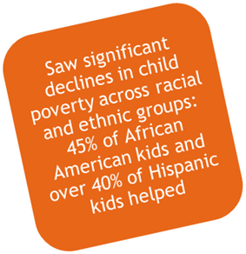
Long-Term Benefits of Income Support
These programs protect against exposure to economic insecurity, which has been shown to harm long-term economic, educational, health and mental health outcomes.
* Joint Economic Committee report

Slide 11
Economic Benefits: Studies
The Joint Economic Committee: each $1 in CTC payments generated $1.25 in local economic activity. This economic activity was a boon to local businesses and helped create jobs in communities across the country.
Columbia University: estimated that the CTC provided $8 in social and economic benefits over the long term for every $1 of investment.
Niskanen Center: estimated that the CTC expansion would boost consumer spending by $27 billion, generating $1.9 billion in revenues from state and local sales taxes and supporting over 500,000 full-time jobs.
Notes:
Niskanen Center is a libertarian “think tank” based in Washington, D.C., advocating for environmentalism, immigration reform, civil liberties, and a national defense policy based on libertarian principles. Niskanen Center was founded in 2014. Jerry Taylor (former vice president of the Cato Institute), environmental activist and policy analyst, is the founder and President of the Niskanen Center. According to an Intercept Interview and Yale.edu, Jerry Taylor used to be global warming skeptic but has now changed his position to become a climate activist.

Slide 12
CTC: The opposing View
Viewed as a middle-class entitlement / Reverse incentive to work
Cost – Over $100B/YR & $1T over 10/YRS if permanent
Unsure how effective it would be w/ kids back in school getting some meals provided
Estimated that 57% of low-income families got the credit because many low/no income families file taxes
Notes:
At the same time, the 2017 law expanded availability of the full CTC to higher-income families by increasing the income level where the credit begins to phase out to $200K for single parents and $400k for married couples.

Slide 13
The Politics
End of session scramble to finish appropriations and other unfinished issues
Faith and Anti-Poverty groups suggest that if there are corporate tax benefits in the Omnibus bill, that the CTC is included as well.
Not only included, but pushing for the expanded CTC that contains the monthly payments
Decisions rest in the hands of the “Big 4” (Pelosi, McCarthy in the House and McConnell and Schumer in the Senate) and House (DeLauro) and Senate Approps Chair and Ranking Member (Leahy and Shelby)

Slide 14
Spending Levels
The “topline” overall budget number announced this week.
Lawmakers need to decide specific non-defense department allocations.
Republicans want a greater increase for defense spending which would leave fewer funds for non-defense programs.

Slide 15
Two Paths Congress Can Take: #1 - The Continuing Resolution (CR)
Current CR ends Friday, 12/16. Congress will pass a short-term CR until 12/23.
CRs kick can down the road keeping spending at current levels. Less likely for extra spending to get attached.
Anti-Poverty groups do not want a long-term CR. Flat funding “acts like” a cut.

Slide 16
Two Paths Congress Can Take: #2 - ThE OMNIBUS (THE CHRISTMAS TREE)
Can contain a multitude of issues (or unrelated bills)
Advocates like this approach to give current/outgoing Senate Approps Chair Sen. Patrick Leahy (VT) and Ranking Member Sen. Richard Shelby (AL) last hurrah
House Minority Leader Kevin McCarthy is not supportive of an Omnibus. Would rather have CR until GOP controls the House

Slide 17
The latest scoop
The Omnibus is being written now and will be finished this weekend.
Congress will debate it next week.
Need to take action now!

Slide 18
ADVOCACY
“We in America do not have government by the majority. We have government by the majority who participate.”
-- Thomas Jefferson

Slide 19
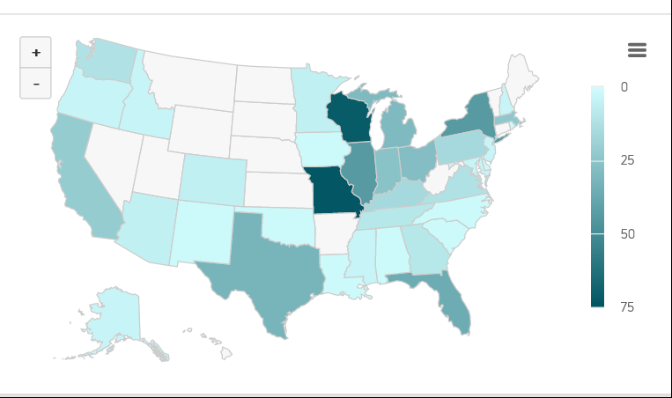
Vincentian Advocacy Roles
Voter Voice - https://votervoice.net/SVDPUSA/home
Schedule in-district meetings
Invite members of Congress and staff to tour your SVdP facilities
Amplify on social media
Share stories
Coalition Letters
Circle of Protection
USCCB/Catholic Charities

Slide 20
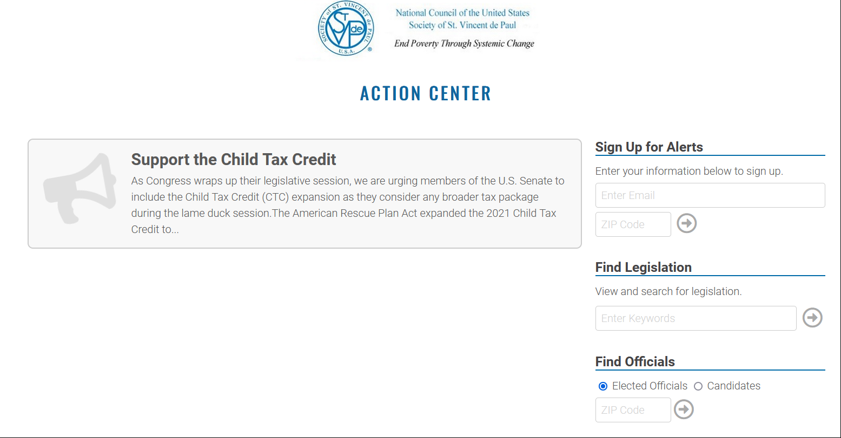
Voter Voice: Our E-Advocacy Site

Slide 21
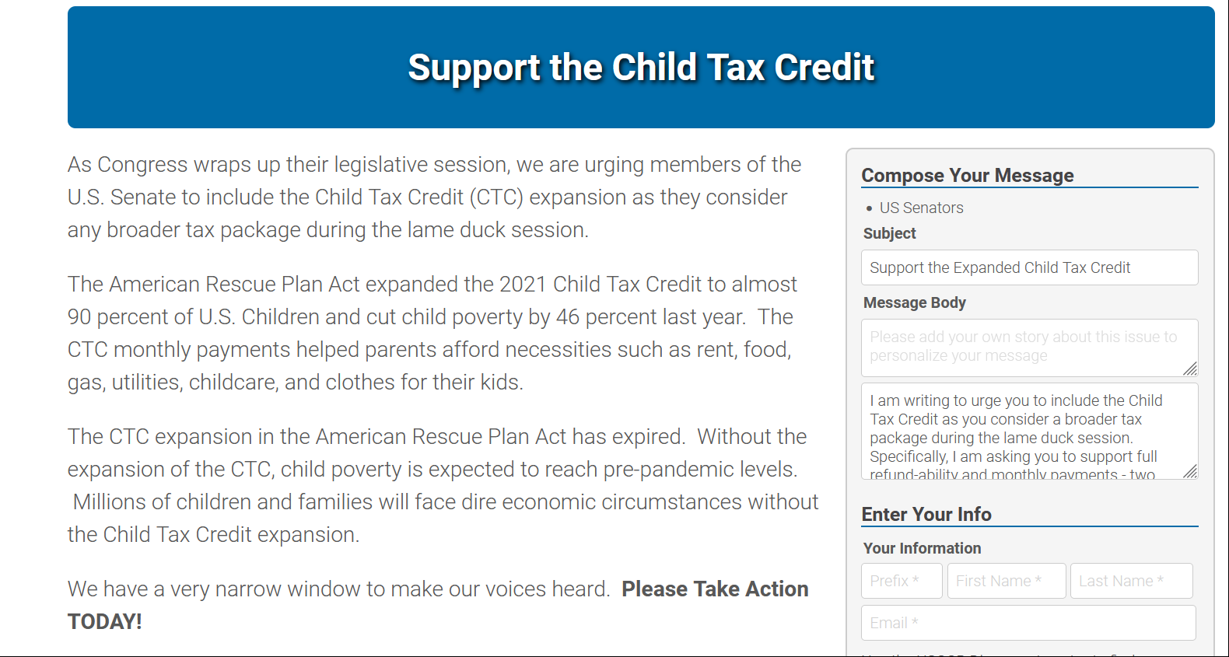

Slide 22
Questions?

Slide 23
CLOSING PRAYER
Honoring Our Lady of Guadalupe
God of glory, To honor the Blessed Virgin Mary you changed Tepeyac’s barren ground into a fragrant garden of flowers.
Transform the rough places of our hearts and of our world, so that our lives may bear the imprint of Mary’s faith and love.
—Benedictine Daily Prayer

